Slide 1
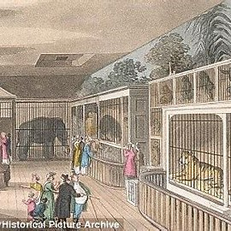
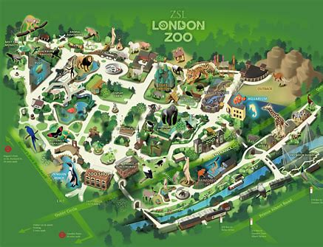
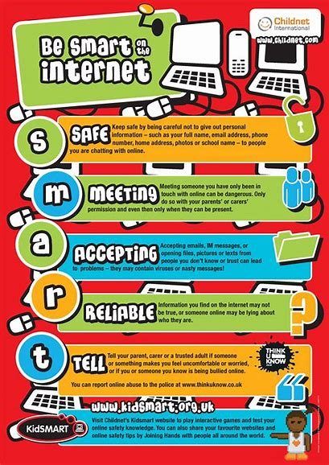
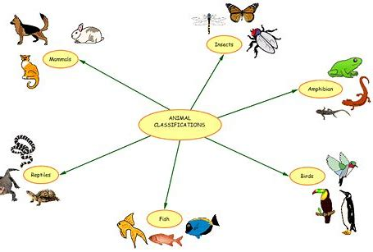
Knowledge Organiser – Autumn 1 2021, Topic name and class
Geography
What I should already know Have a sense of my locality such as my house, school and village. Some experience of looking at maps. Have some directional language. | The Journey Learning about the different types of maps and why people use them. Looking at zoo maps and creating our own zoo maps. We will locate animals at London Zoo using compass directions and also discover directions within our classroom. We will use grid references to locate objects on a map.
Key Vocabulary Map Features Directions Compass Grid reference | What I will know by the end of the unit How to use grid references on a map to locate specific objects. I will know the directions of a compass and how to use a compass. I will be able to draw my own map of a zoo considering it’s specific features.
History
What I should already know Yr1’s have an understanding of own past e.g. families, birthdays and growing. Yr2’s Awareness of the past and chronological understanding of periods. | The Journey We will discover all about why London zoo was set up and the impact it has had on zoo’s today. We will take a look at our local Zoo ‘ Twycross Zoo’ and discuss how Zoo’s have changed over the years but learn that conservation is still at the heart of a Zoo’s ethos.
Key Vocabulary Ethos Zoologist Zoological society of London (ZSL) London Zoo Twycross Zoo Conservation | What I will know by the end of the unit The history behind zoo’s in the UK such as the year London Zoo was established as the first Zoo of it’s kind and the History behind our local zoo which is Twycross zoo, understanding the contribution that Zoo’s make to conservation, education and science.
Knowledge Organiser – Autumn 1 2021, At the Zoo Class 1
Science
What I should already know Understand the concept of similarities and differences. Have some knowledge of animals and be able to begin to group them in different ways. | The Journey We will have a go at categorising and grouping animals in different ways. We will then discover the different classifications of animals. We will also look at different animal adaptations.
Key Vocabulary Birds Group Fish Classify Amphibians Compare Reptiles differences mammals invertebrates similarities | What I will know by the end of the unit I will know the different classifications of animals. I will have looked at different animal adaptations. I will understand what working scientifically means.
Computing
What I should already know Have an awareness of the technology around us. Have experience of using some technological toys. Have used simple age appropriate computer programmes. | The Journey We will refresh our knowledge on e safety and produce a poster. We will acquire basic computer skills such as opening programmes and saving our work. We will also look at retrieving information and mouse control. Children will begin to acquire skills in typing on a keyboard.
Key Vocabulary Saving Internet safety Technology Retrieving Mouse Typing | What I will know by the end of the unit I will be able to use a mouse competently. I have begun to type on a keyboard. I can open a programme and save my work I will know that you can use computers to retrieve information. I will have an understanding of the importance of being safe when using technology.

Slide 2
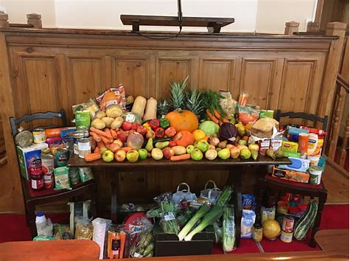
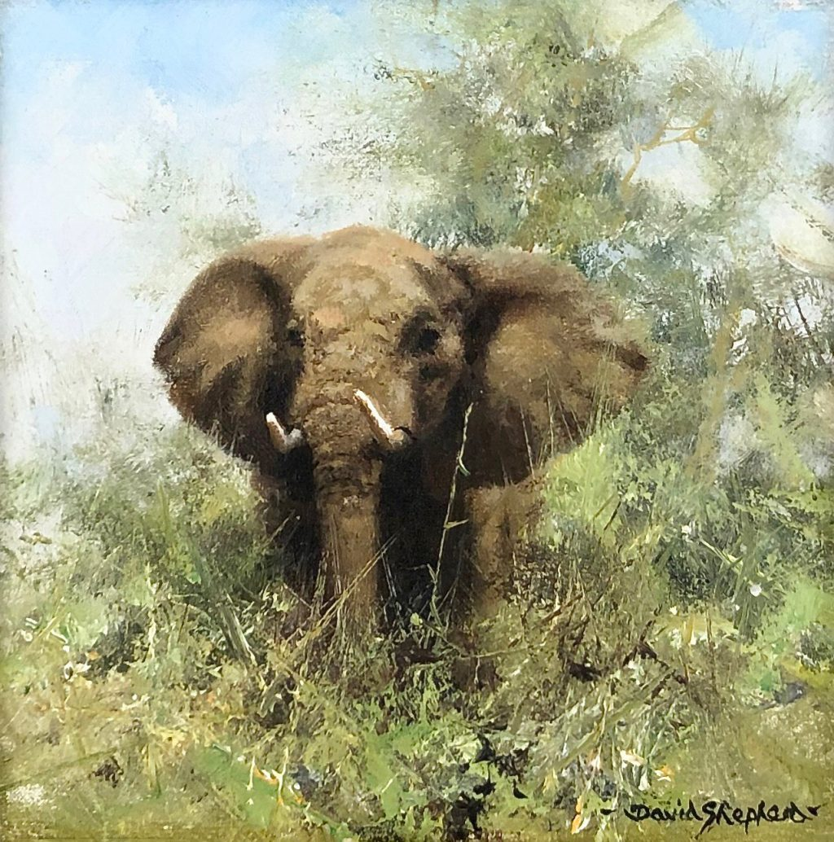
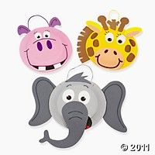
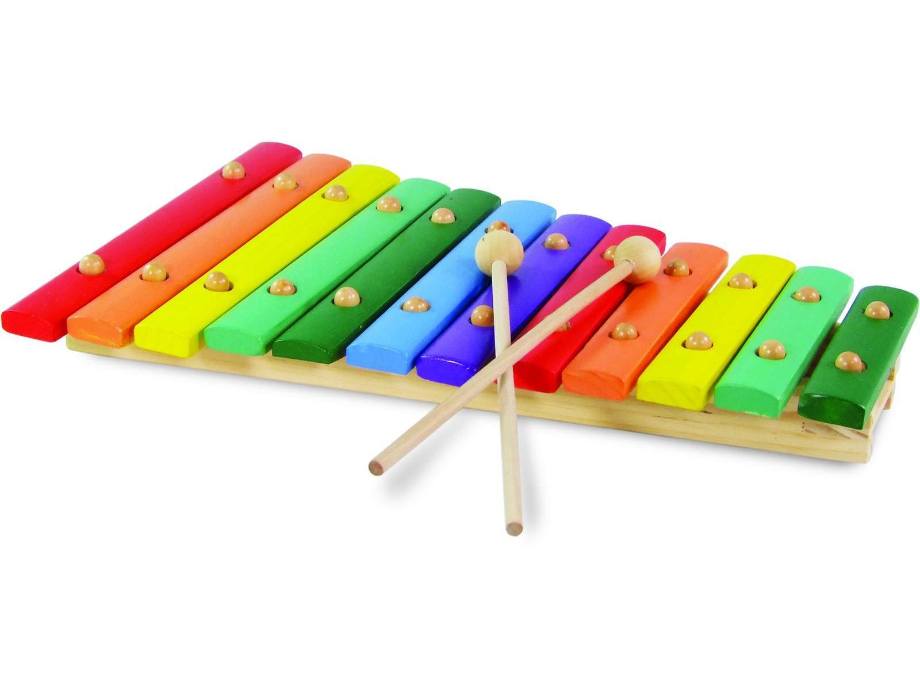
PSHE
What I should already know Already have experience of taking part in circle time. Understand the concept of families and how they might be different to others | The Journey We will look at family life and how that looks for different people. We will discover the similarities and differences between our home and school and the homes and schools of others from around the world.
Key Vocabulary Charity Family People Similarities Differences Togetherness Love | What I will know by the end of the unit I will know that not every family is the same. That there are similarities and differences to peoples homes and schools around the world.
RE
What I should already know What makes us special and why. What a church looks like and why people might visit a place of worship | The Journey We will visit our local church to celebrate the harvest festival. We will recap key aspects of Christianity.
Key Vocabulary Place of worship Holy book Religious figures Festival Church Christianity | What I will know by the end of the unit Why people go to a place of worship Understand key aspects of Christianity. I will have first hand experience of visiting a church for a festival.
Art
What I should already know Previous experience of exploring a variety of materials, tools and techniques including painting, collage and drawing. | The Journey We will use a range of materials creatively to design and make products. Learning about David Shepard and attempting out own wildlife art.
Key Vocabulary Artist Wildlife Collage Painting Drawing Collage | What I will know by the end of the unit I am able to recall facts about David Shepard the wildlife artist and have experience of his work. I will have had further opportunities to work creatively in a variety of different ways.
Knowledge Organiser – Autumn 1 2021, At the Zoo Class 1
Music
What I should already know Already have experience of singing songs and rhymes. To have experimented with some instruments and being able to tap out simple repeated rhythms. | The Journey We will learn a variety of songs singing in tune and expressing ourselves through adding our own actions to the lyrics. We will be using a variety of instruments to develop our own sound stories.
Key Vocabulary Instruments Rhythm Singing Expression Creativity | What I will know by the end of the unit I will have learnt a variety of songs linked to our topic. I will have added sounds into stories using a variety of instruments.
Design Technology
What I should already know I should have experience with modelling with play doh. Have previous experience of manipulating materials to achieve a planned effect. I will have constructed with a purpose in mind. | The Journey We will design, make and evaluate our own clay animals. We will be constructing our own animal masks .
Key Vocabulary Clay Evaluate Construct Materials Design Sculpting | What I will know by the end of the unit I will understand the process of designing making and evaluating my own product. I will have built on my previous experience of constructing and manipulating materials.
MFL
Key Phrases Hello My name is… I am…. Years old. I live in……. I live with……
PE
Key skills Participating in a team sport (basketball). Develop attacking and defending skills. Develop balance, agility and co-ordination skills. Master basic movements e.g. running, jumping, throwing and catching within a range of activities.

