Slide 1
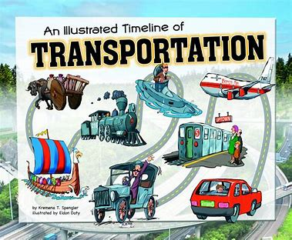
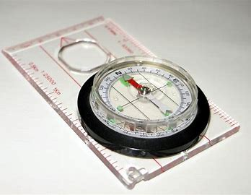
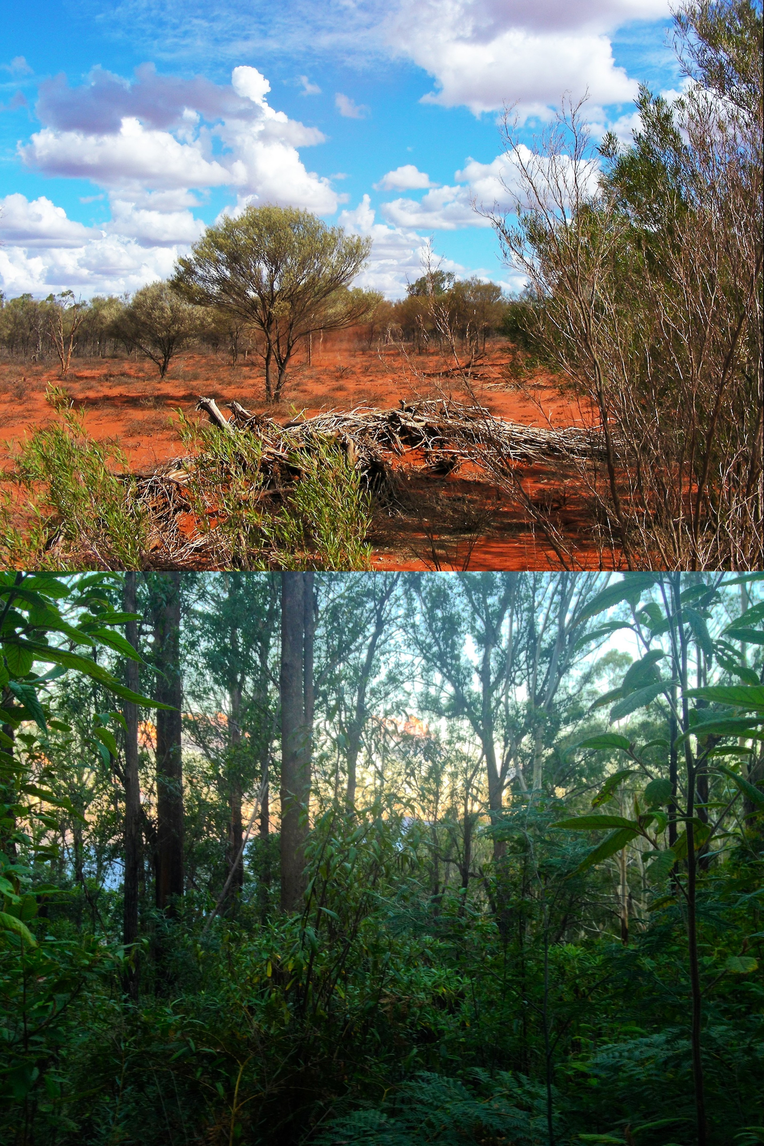
Knowledge Organiser – Autumn 2 2021, Habitats Class 1
Geography
What I should already know I know what a compass is and can label one correctly. I have some experience of looking at maps. I can use directional language including the point of a compass as a reference in giving directions. | The Journey I will further develop my compass skills through the use of a real compass and applying my knowledge to different situations such as orienteering.
Key Vocabulary Directions Compass Orienteering | What I will know by the end of the unit I will know how to use a compass effectively. I will have applied my knowledge and skills to complete an orienteering activity.
History
What I should already know I have an awareness of the past and chronological understanding of periods. I know about different types of transport. | The Journey I will look at the different journeys people make and why. I will learn about the different types of transport and how that has changed over the years comparing transport from the past until the modern day.
Key Vocabulary Transport Journey Modern day Past Present | What I will know by the end of the unit I will know how transport has changed over the years. I can talk about the different types of transport. I have a sense of how things change over time. I understand why transport has become a big part of peoples journeys.
Science
What I should already know I can talk about the features of my own environment. I have started to look at different habitats and how animals have adapted to live there. | The Journey Learn about different habitats including the rainforest, desert and our local habitat. Specifically forests and ponds. We will go on a trip to Rutland water to discover more about our local habitat and to learn about the effect the change in seasons have on our local habitat.
Key Vocabulary Habitats Similarities Differences Climate Adaptations Environment | What I will know by the end of the unit I know that most living things live in habitats to which they are suited. I understand how different habitats provide for the basic needs of different kinds of animals and plants, and how they depend on each other.
Computing
What I should already know I will be able to use a mouse competently. I have begun to type on a keyboard. I can open a programme and save my work. I will know that you can use computers to retrieve information and have used age appropriate programmes. I will have an understanding of the importance of being safe when using technology. | The Journey I will research habitats on the internet. I will learn how to use PowerPoint and create my own slide show on a habitat of my choice. I will practise my typing skills to add information to my slides.
Key Vocabulary Internet Slide Show PowerPoint Research Typing Saving Internet safety | What I will know by the end of the unit I will know that information can be retrieved from the internet and that it is a good source for research. I will know how to use PowerPoint and will be able to independently make my own slide show. I will have developed my typing skills further.

Slide 2
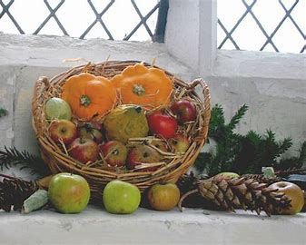
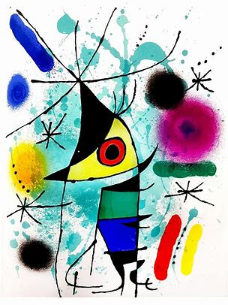
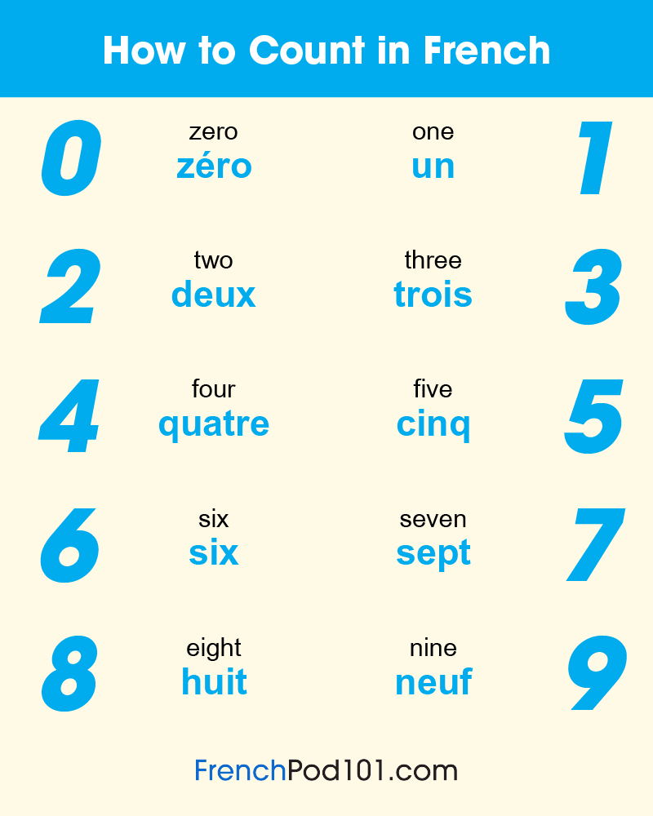
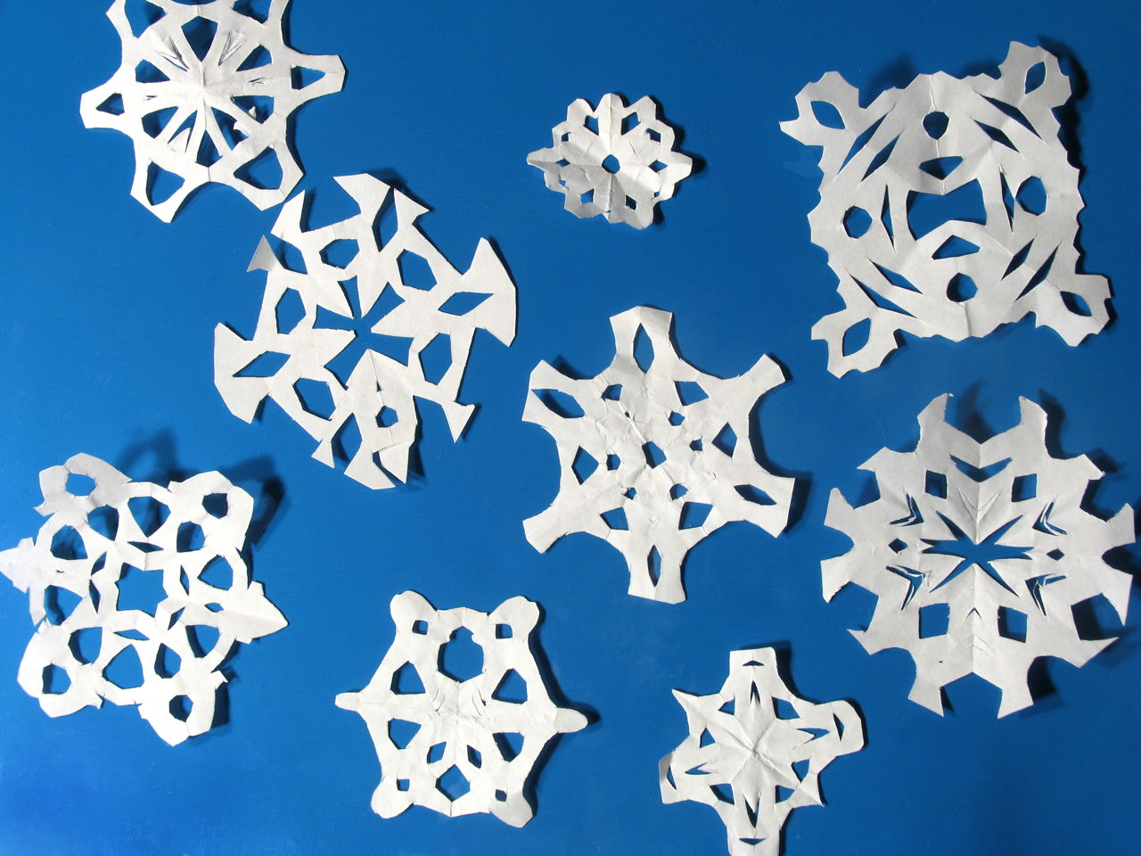
PSHE
What I should already know Already have experience of taking part in circle time. I will know that not every family is the same. That there are similarities and differences to peoples homes and schools around the world. Experience of Bonfire night and reasons why we need to be safe. | The Journey I will learn about fire safety and the risks Bonfire night can bring. I will learn about my rights and the rights of others through mutual respect and acceptance that everybody is different. I will learn the importance of protecting our rights and being fair.
Key Vocabulary Fire safety Rights Protect Respect Acceptance | What I will know by the end of t the unit I will know understand fire s safety. I will know some of my rights and the rights of others.
RE
What I should already know Why people go to a place of worship and understand key aspects of Christianity. What a church looks like and why people might visit a place of worship. | The Journey I will visit a church and take part in the harvest festival celebrations. I will look at how and why Christians celebrate special and sacred times.
Key Vocabulary Place of worship Holy book Religious figures Festival Church Christianity Harvest Festival | What I will know by the e end of the unit I will have visited a Christian place of worship and taken part in a special celebration. I will understand the different ways Christians celebrate.
Art
What I should already know Previous experience of exploring a variety of materials, tools and techniques including painting, collage and drawing. Knowledge of different artists. | The Journey Learn about Yayoi Kusama and create an inspired artwork of our own using dots. Learn about Joan Miro and create our own magic realism and surreal pieces of artwork.
Key Vocabulary Realism Surrealism Sculpture Printing textures | What I will know by the end of the unit How to create textures in our art work through using various techniques such as lines and dots. I will understand that art takes many different forms and is open to interpretation.
Knowledge Organiser – Autumn 2 2021, Habitats Class 1
Music
What I should already know Already have experience of singing songs and rhymes. I have experimented with some instruments and added my own sounds to stories. I can tap out simple repeated rhythms | The Journey I will experiment with changing the tempo and volume when playing a variety of instruments. I will have learnt a variety of songs for Harvest festival.
Key Vocabulary Tempo Volume Performance Instruments Rhythm Singing | What I will know by the end of the unit I will understand the effects that changing the tempo and volume can have on a piece of music. I will have performed Harvest festival songs alongside the whole school.
Design Technology
What I should already know I should have experience with modelling with clay. Have previous experience of manipulating materials to achieve a planned effect. I will have constructed with a purpose in mind. | The Journey Using my cutting skills and paper I will manipulate it to my desired effect of a snowflake. I will create my own habitat using a range of materials to fit inside a shoebox.
Key Vocabulary Construction Textiles Materials Evaluate Purposeful design | What I will know by the end of the unit I will understand the process of designing making and evaluating my own product. I will have built on my previous experience of constructing and manipulating materials
MFL
Key Phrases French numbers to 10 Days of the week I am ……years old.
PE
Key skills In gymnastics I will be developing my balance, agility and coordination. As well as learning to control my movements such as jumping and rolling. I will be continuing to develop my key skills by participating in team games during weekly multisport lessons.

