Slide 1
Knowledge Organiser – Autumn 2 2021, World Pizza (Class 2)
Geography
What I should already know How to locate the worlds countries by using maps. How the lives of people living in other countries might differ from our own. | The Journey To investigate where food comes from. To form a debate stating reasons for and against food exportation. To identify where food comes from on a map by using an atlas. To explore the distance food can travel when imported from overseas. To understand the importance of fair trade.
Key Vocabulary | What I will know by the end of the unit How to recognise the advantages and disadvantages of food miles. To be able to communicate geographical informal in a variety of ways. To understand the importance of fair-trade.
Food miles | Atlas | Import
Export | Fair trade | Labour
Countries | Distance | Overseas
Science
What I should already know To recognise that questions can be answered in different ways, Observed closely, using simple equipment. Performed simple tests. Used observations and ideas to suggest answers to questions. Gathered and recorded data. | The Journey To explain ways that electricity is generated. To identify electrical appliances and the types of electricity they use. To predict and test complete and incomplete circuits. To identify and sort materials into electrical conductors or insulators. To explain how a switch works and why they are needed. To record and report on an investigation.
Key Vocabulary | What I will know by the end of the unit How a switch turns the electric current on and off.
Computing
What I should already know I will have typed on a keyboard and began to develop my typing skills. I will have used PowerPoint and be able to independently make my own slideshow. I will have an understanding of the importance of being safe when using technology. | The Journey To use basic computer skills. To change the case of text. To align text. To use bullet points and numberings. To use the <ctrl> key. To insert and format text boxes.
Key Vocabulary | What I will know by the end of the unit How to select single words. To cut, copy and taste text. How to change the format of the font and insert images. To copy and screenshot into another application. How to use a secure password. To use keyboard shortcuts.
Electric current | Buzzer | Motor
Switch | Cells | Electrons
Circuit | Insulator | Conductor
Insert | Copy | Cut
Paste | Text | Keyboard
Screenshot | Format | Shortcut

Slide 2
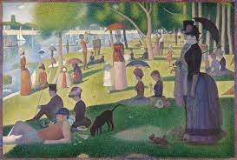
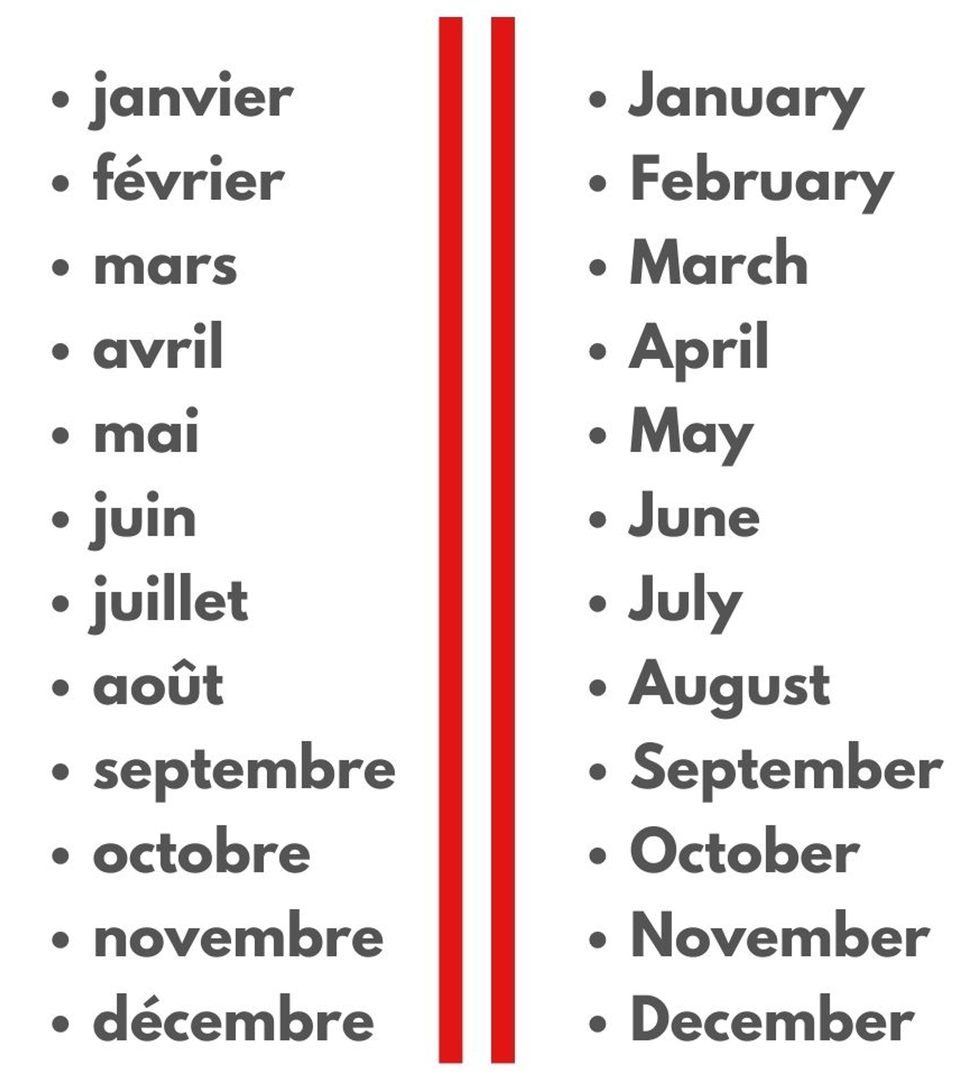
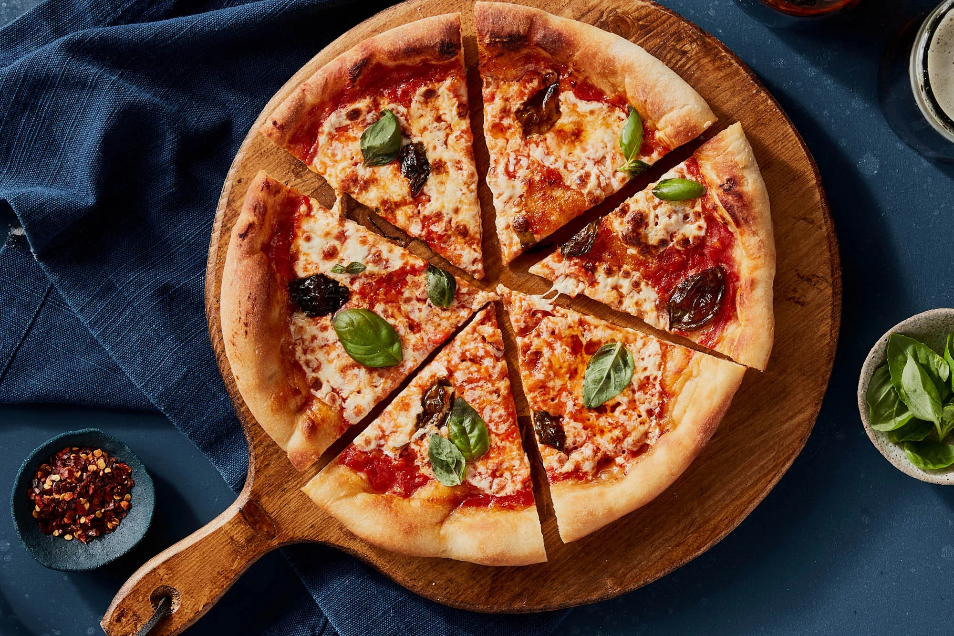
PSHE
What I should already know What rights are and what rights people share. Explain how people protect their rights. Show respect for the rights of others. Understand why it is important to be fair. | The Journey To understand that there are basic human rights shared by all people. To research, discuss and debate topical issues. To know what democracy is. To understand that universal rights are there to protect everyone. To recognise and challenge stereotypes.
Key Vocabulary Human rights, democracy, stereotypes universal, equal | What I will know by the end of the unit What makes human right universal. What democracy is and how this relates to rules and human rights. Understand why it is important to respect the rights of others.
RE
What I should already know The similarities and differences between the main religions around the world | The Journey To think of reasons why some people choose to celebrate significant events. To learn about a range of religious festivals and understand why they are celebrated. To discover what we can learn from celebrations and festivals.
Key Vocabulary Festival, Diwali, Easter, Eid ul Fitr, Pesach, difference, similarities, Muslims, Christians, Hindus, Jews. | What I will know by the end of the unit The similarities and differences in the way festivals are celebrated within and between religions. What is worth celebrating and remembering in religious communities as well as in our own lives.
Art
What I should already know The work of a range of artists, describing differences and similarities between different practices and making links to their own work. | The Journey To find who Georges Seurat is and explore his style of art. Explore how to create art in the style of pointillism. Explore how colours are used. Explore Seurat’s painting and how he created effects and shading. Study other pointillist artists.
Key Vocabulary Artist, pointillism, Georges Seurat, technique, media, effects, shading, texture, pattern, colours. | What I will know by the end of the unit To create a piece of pointillism artwork.
Knowledge Organiser – Autumn 2 2021, Wold Pizza (Class 2)
Music
What I should already know Experimented with, created, selected and combined sounds using the inter-related dimensions of music. | The Journey To learn how long a crotchet and quaver last. To read, clap and play crotchets, quavers, rests, minims and semibreves.
Key Vocabulary Notations. Crotchet, quaver, rest, minims, semibreves, composition. | What I will know by the end of the unit To write musical composition.
Design Technology
What I should already know The principles of a healthy and balanced diet | The Journey To recognise what ingredients is needed to make bread. To plan and design a pizza. To make a pizza using a range of toppings.
Key Vocabulary Pizza, ingredients, toppings, tools, purpose | What I will know by the end of the unit Design and make a pizza using a range of toppings.
MFL
Key Phrases
PE
Key skills Develop flexibility, strength, technique, control and balance through gymnastics.

