Slide 1
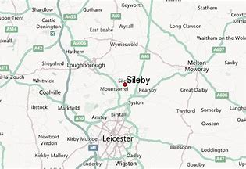
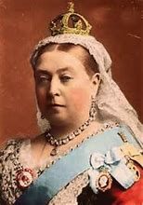
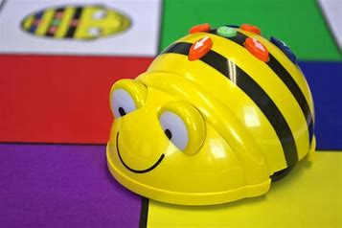
Knowledge Organiser – Spring 1 2021, Traditional Tales Class 1
Geography
What I should already know Have an awareness of our local area and it’s features. Have experience of looking at different maps. Have a sense of our locality. | The Journey We are going to compare Seagrave and the surrounding area of Sileby. We will look at the local features such as parks, Churches and shops. We will explore the changes over time by looking at ordinate surveys of both areas. As well as looking on google earth for more recent images. We will have a go at drawing our own map.
Key Vocabulary Features Local area Seagrave similarities/differences Sileby Maps Ordinate survey | What I will know by the end of the unit To be able to distinguish between Sileby and Seagrave comparing differences and similarities. Have made our own map of the local area.
History
What I should already know That we have hand kings and Queen’s in this country for a very long time. That Elizabeth II is the current Queen. Have a sense of the past and how things have changed over time. | The Journey We are going to look at different significant Kings and Queens from the past who have contributed national and international achievements. In doing so we can also understand what life was like living within these periods of time.
Key Vocabulary Queen Victoria Monarchy King Richard III Queen Elizabeth I Chronology | What I will know by the end of the unit Can recall some key facts about the British Monarchy and understand the chronology of various significant Kings and Queens such as Queen Elizabeth I, King Richard III and Queen Victoria. Have an understanding of life in those times and how it is different to how we live now.
Science
What I should already know What working scientifically means. Understand the difference between solid and liquid. Have experimented and investigated with different materials before. | The Journey Working scientifically we will look at materials specifically reversable and irreversible changes. We will look at changing solids to liquids through melting ice and wax and see it they can be reversed back to it’s solid state. We will then spend an afternoon investigating eggs, cooking them in different ways noting the changes and deciding weather they are irreversible or not.
Key Vocabulary Reversable Irreversible Materials Investigate Evaluate Changes | What I will know by the end of the unit What irreversible and reversable means. Used scientific language. Carried out an experiment with various materials. Investigating and evaluating the changes in the materials going from a solid to a liquid state.
Computing
What I should already know How to use a mouse and open and use a basic ICT programme. Have used remote controlled software controlling the direction in which it is travelling. Directional language. | The Journey We will learn what algorithms are and how they are used within programmes of digital devises. We will explore using Beet bots coding our own instructions and look at programmes such as Roamer and 2go which we will link in to our topic of traditional tales.
Key Vocabulary Algorithm Coding Digital devices Debug Programmes Information technology | What I will know by the end of the unit How to successfully create precise and unambiguous instructions to run a programme. What algorithms are and the role they play within programmes on digital devises. Recognise common uses of technology.

Slide 2
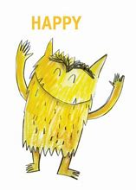
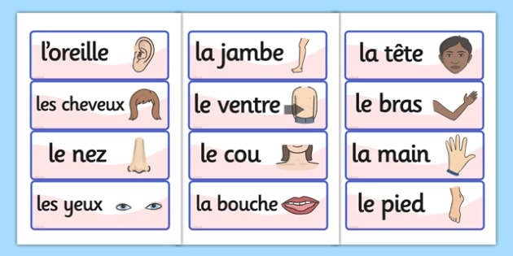
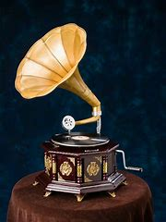
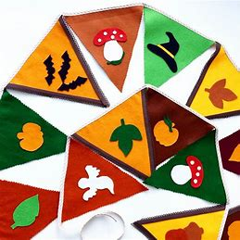
PSHE
What I should already know Understand the concept of conflict resolution. Developed a growth mindset over a fixed mindset. Have an awareness that everyone if different but we all have the same rights. | The Journey Read the Colour Monster to explore the different emotions we might feel. Explore ways to think/ feel happy. Learn about making the right choices whilst recapping conflict resolution. Circle time to give opportunity to listen to different opinions and things to be thankful for.
Key Vocabulary Positivity Conflict resolution Good choices Goals Achievements Opinions Thankful | What I will know by the end of the unit How to articulate my feelings. Respecting others opinions. Have the understanding to make good choices. To be thankful and proud of our achievements.
RE
What I should already know To have taken part in the interactive story of Rana and Sita. To have experience wearing traditional clothing whilst learning traditional dances. | The Journey Learn about the values of Hinduism. Explore Hindu God’s and Goddesses. Read the story of Krishna.
Key Vocabulary Values Hinduism God’s / Goddesses Faith Place of worship. | What I will know by the end of the unit Understand the main values of Hinduism. Know some of the most popular God’s and Goddesses. Have heard of another Hindu story.
Art
What I should already know Have used paint before to make a piece of art to the desired effect. Confident in naming primary and secondary colours. Understands that you can mix colours to make another colour. | The Journey Explore mixing colours to make other colours, shades and tints. We will explore the art of different abstract artists to create paintings using our own mixed paints.
Key Vocabulary Secondary Primary Tertiary Piet Mondrian Mark Rothko Paul Klee Jackson Pollock | What I will know by the end of the unit Explore the work of a range of abstract artists. Mixed a range of secondary and tertiary colours. Mixed different shades and tints to produce own artwork.
Knowledge Organiser – Spring 1 2021, Traditional Tales Class 1
Music
What I should already know I can appreciate a range of music. Used my voice to creatively and expressively. | The Journey Continue to appreciate a range of music through looking at the history of music within living memory. We will listen to and sing the songs that our grandparents and parents would have listened to and compare it to the music we listen to now.
Key Vocabulary Appreciate Gramophone Past Rhythm Popular music | What I will know by the end of the unit Experienced how music has changed within living memory. Learnt new songs that people have listened to for generations. Learnt to appreciate a range of music. Performed to topic based music within dance lessons. To develop an awareness of the past.
Design Technology
What I should already know Selected from and used a variety of tools and equipment to perform a practical task. Experience of selecting and using a range of materials. | The Journey Design our own bunting. Select from a variety of textiles to create our own bunting. Explore different ways of joining the materials. Evaluate our final product.
Key Vocabulary Textiles Materials Bunting Evaluate Joining | What I will know by the end of the unit I can design, create and evaluate my bunting. Saying what went well and what I could do it improve it.
MFL
Key Phrases Recap numbers to 10 Labelling parts of the body Animals
PE
Key skills PE- Participate in team building games. Learning simple tactics for attacking and defending. Dance – Perform dances using simple movement patterns.

