Slide 1
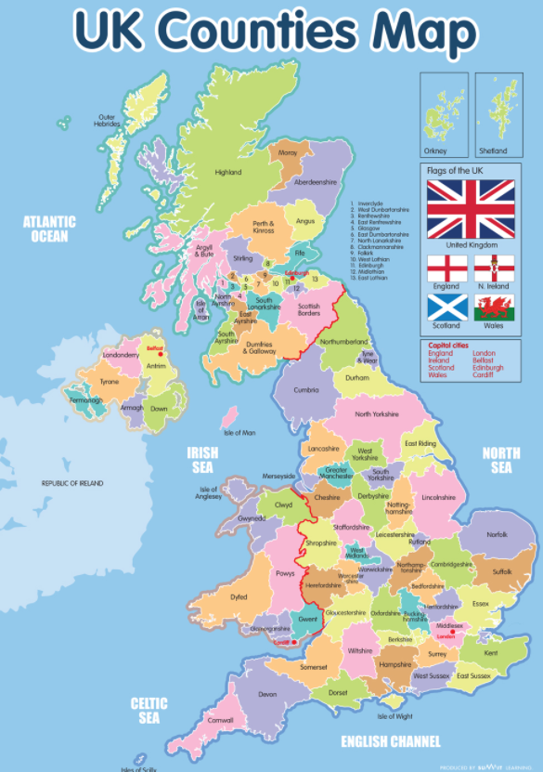
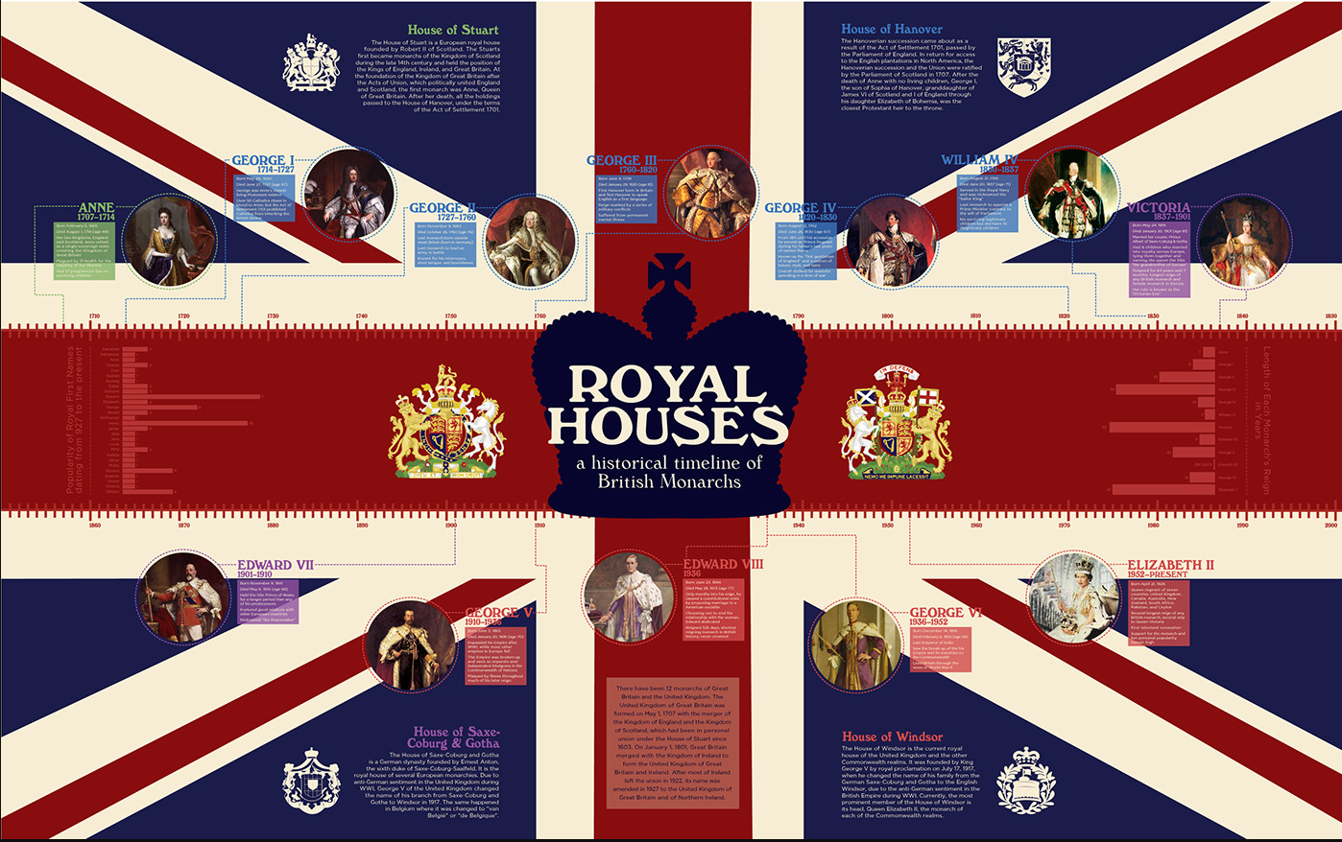
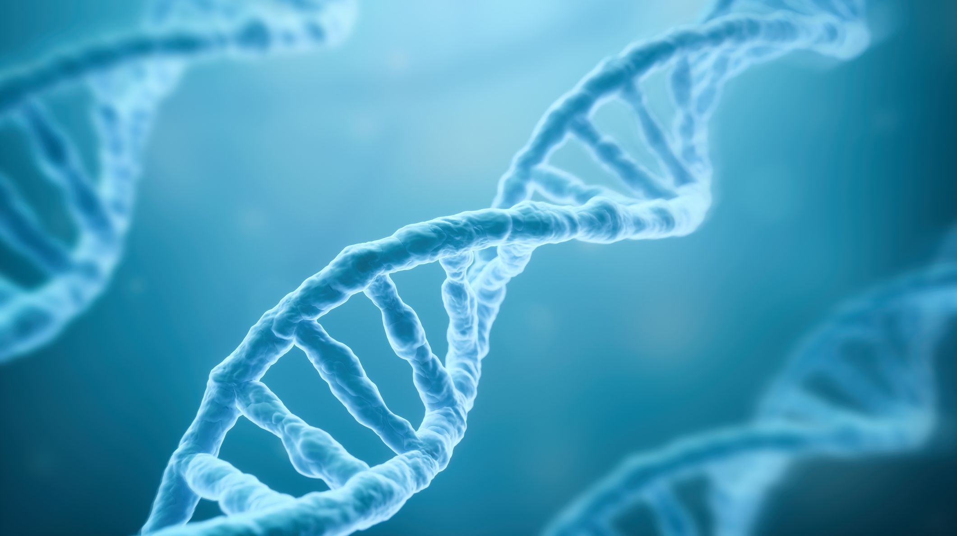
Knowledge Organiser – Autumn 1 2021, Monarchs Class 3
Geography – English Counties
What I should already know My learning has been extended outside my local area to the rest of the country, Europe, and America. I know about important physical and human features around the world, and have increased my understanding of locations and specific places. | The Journey I will find cities in the UK and locate counties. I will be able to identify human and physical geographical features in the UK. I will also look at comparisons in Europe
Key Vocabulary Great Britain United Kingdom Latitude Longitude Physical/human features Geographical similarities Counties | What I will know by the end of the unit I will be able to locate the counties and cities of the United Kingdom, and key geographical regions. Learning should also focus on human and physical features, land-use patterns, and key topographical features including hills, mountains, rivers, and coasts - with understanding of how they’ve changed over time.
History - Monarchs
What I should already know I have an understanding of chronology and have learned about the Tudors and King Henry V111. | The Journey To study in depth all about other Monarchs. To study changing powers of Monarchs using case studies such as John, Anne and Victoria.
Key Vocabulary Monarch chronology Tudors Realm Empire Chronology State power Identity process perspective complexity evidence judgement | What I will know by the end of the unit I will be inspired and have curiosity to know more about the past. I will be encouraged to ask perceptive questions, think critically, weigh evidence, sift arguments, and develop perspective and judgement. I will understand the complexity of people’s lives, the process of change, the diversity of societies and relationships between different groups, as well as my own identity and the challenges of my time in the world.
Science – Inheritance and Evolution
What I should already know I can identify that animals, including humans, need the right types and amount of nutrition, and that they cannot make their own food; they get nutrition from what they eat and that humans and some other animals have skeletons and muscles for support, protection and movement | The Journey Inheritance, animals, plants, humans, parent, offspring, similarities, differences, characteristics, variation
Key Vocabulary Evolution, adaptation, human intervention, selective breeding, environment, inherited traits, genetic, genes, modification | What I will know by the end of the unit I can understand that adaptations are mutations. I can identify adaptive traits. I can demonstrate understanding of how ideas about evolution developed over time. I can explain the terms adaptation, evolution and natural selection. I can examine fossil evidence. I can explain how a living thing has evolved over time. I can identify adaptive traits in humans as a species. I can describe the known stages of human evolution. I can compare modern humans with members of the same genus and family.
Computing – e-safety
What I should already know | The Journey Investigate and talk about the impact of electronic communication – including phishing emails. Understand about features of reliable and unreliable websites To understand hidden costs on the internet Understand what I should and shouldn’t share online Safe passwords Cyber-bulling and the consequences | Key Vocabulary Phishing, copyright, plagiarism, fair dealing, cyber bulling, appropriate, content, reliable, unreliable, secure, passwords
 | What I will know by the end of the unit How to use technology safely, respectfully and responsibly; recognise acceptable/unacceptable behaviour; identify a range of ways to report concerns about content and contact To use search technologies effectively, appreciate how results are selected and ranked, and be discerning in evaluating digital content

Slide 2
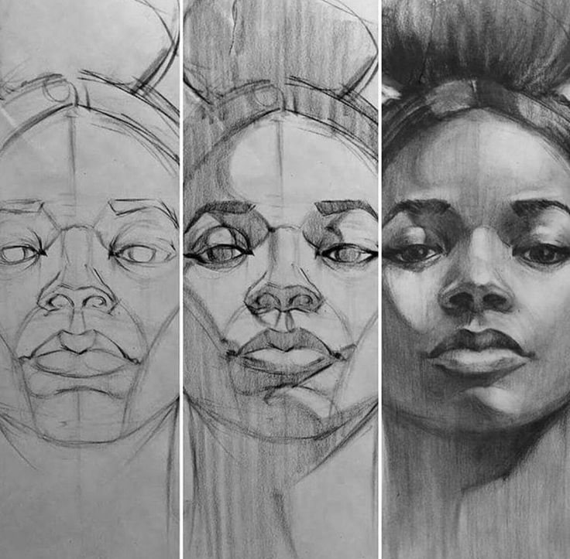
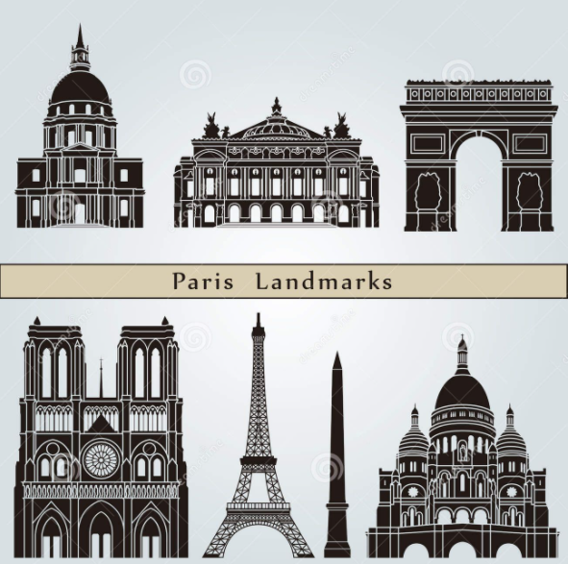
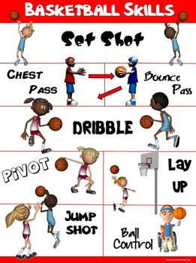
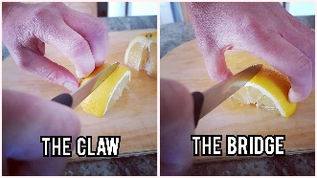
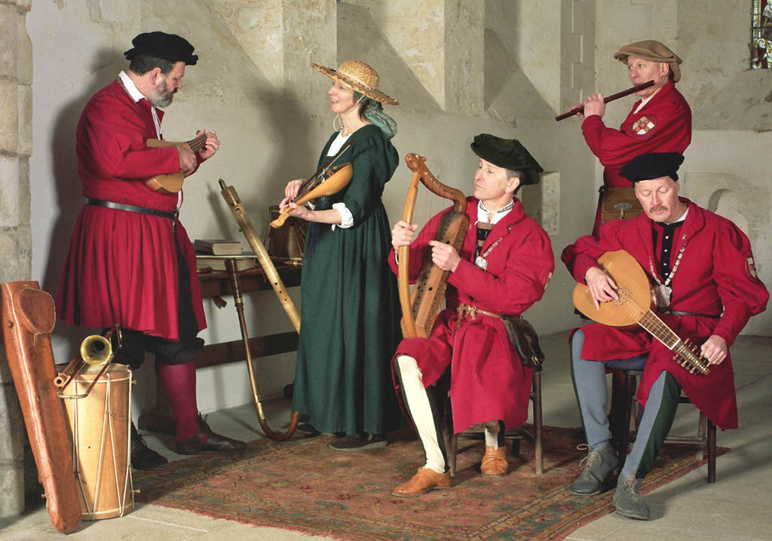
PSHE
What I should already know I can give reasons for similarities and differences between people’s lives. I can talk about fairness. I can give reasons for their own opinions. I can recognise how their actions impact on people in different countries. I can discuss climate change in terms of what it is and its effects. | The Journey Explore the meaning of ‘Global Citizenship’ What does it mean to be a Global Citizen What is Global warming? Why is it import to conserve water? What is biodiversity? How can we make the world a better place?
Key Vocabulary Citizen, global, responsible, aware, human right, respect, compassion, prevent, persuade, global warming, conserve, biodiversity, | What I will know by the end of the unit I will be able to explain what a global citizen is I will be able to talk about ways to prevent Global warming I will be able to talk about the impact of my choices
RE
What I should already know Christian dates in the calendar To be able to retell the story of Jesus and his disciples and understand parables and what they were all about. | The Journey What different symbols are important to the Christian faith? ’ What are the meaning of the various Christian symbols?’ Do all Christians believe in the creation story?’ How do they think the world was created? What do some atheists believe? Other Christians believe? With these questions I will explain describe and discuss my views.
Key Vocabulary Symbols, Prayer, Sabbath, Creation, stain glass windows, altars, pulpits, font, lectern | What I will Know at the end of the unit To confidently be able to discuss their understanding of their own beliefs in Christianity. To be able to describe and explain the creation story and where how and why Christians pray. To show and have a good ability of debating showing for and against.
Art
What I should already know I have had experience of a range art and design techniques, including drawing with a range of materials. I have sketched and used coloured pencils to shade | The Journey Draw a range of self portraits using different techniques including split face portraits, symbolism and unusual materials. Learn about portrait artists and emulate their style. Experiment with pencil hardness
Key Vocabulary Sketch, self portrait, split-face, symbolism, artwork, shade, hardness, portray emotion | What I will know by the end of the unit I will have recorded my observations, applied a range of techniques, created a self portrait and be able to discuss art work
Music
What I should already know I should be taught to sing and play musically with increasing confidence and control. They should develop an understanding of musical composition, organising and manipulating ideas within musical structures and reproducing sounds from aural memory. | The Journey To listen and learn about Tudor music in the early 18th Century. Listen and develop an opinion. Look at types of instruments and how music is made . Look and learn musical notation on manuscript paper and see how mathematics is heavily involved in the writing of music and how it is played on instruments. Use of percussion instruments to develop our skills and understanding
Key Vocabulary treble/bass clef, Crotchet minim stanza, Stave key crescendo | What I will know by the end of the unit I can create music, which reflects given intentions and uses notations as a support for performance. I know and use standard musical notation of crotchet, minim and semibreve. To indicate how many beats to play.
Design Technology
What I should already know How to measure and cut paper and cardboard. How to use joining materials. Basic combining of ingredients | The Journey Explore method to to strengthen, stiffen and reinforce complex structures through observation, experimentation and practical task. I will use this knowledge to create a picture frame. Create dishes from the past using a range of techniques.
Key Vocabulary User, choice, stiffen, frame, sturdy, planning, reinforce, quality Whisk, claw, bride, cream | What I will know by the end of the unit How to design and make a picture frame that will stand up and hold one of my self-portrait pictures. How to use claw, bridge, creaming and whisking techniques. I will be able to talk about seasonality
MFL
Key Phrases Country names – le Royaume-Uni, La France Quelle est la distance entre? C’est … kilometres Compass directions – le nord, le sud, l’est, l’oust French landmarks – La tour Eiffel, l’Arc de Triomphe J’habite en/au
PE
Key skills Basket Ball – dribbling, passing, keeping possession, footwork, team work, warming up, cooling down, self and peer evaluation Multi-sports (Quidditch) – Use of space, moving with a ball, attacking, defending, team work, throwing and catching, warming up and cooling down, evaluation

Slide 3
Topic 20 Quiz Autumn 2021– Monarchs Autumn 1
Geography/History
Geography Name 5 cities and 5 Counties in England? What is are human and physical features? Give an example of each Why do we have longitude and latitude on a map? History Name 3 English Monarchs and provide some key information about them.
PSHE
What is biodiversity? How can we make the world a better place?
RE
What different symbols are important to the Christian faith? What are the meaning of the various Christian symbols?
Music
What is your opinion of Tudor music? How many beats do you play for a: Crotchet Minim Semibreve
Computing
Describe 3 ways to stay safe online How do you report inappropriate content?
Science
What are the stages of human evolution? Explain these words.. Adaptation Evolution Natural selection
Art and Design/ Design Technology
Art Describe the techniques you’ve used to create portraits this term. Design What is the claw and bridge technique used for? Draw a diagram to show these techniques.
Vocabulary – define these words
Crotchet
Shade (in relation to art)
Plagiarism
Realm

