Slide 1
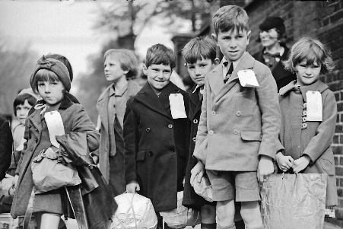
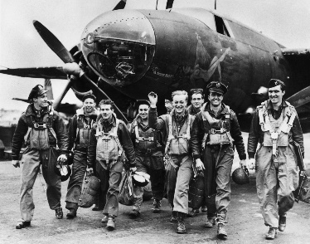
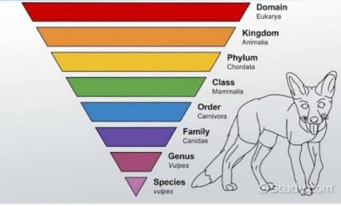
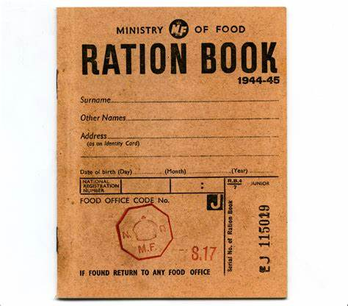
Knowledge Organiser – Autumn 2 2021, World War II Class 3
Geography
What I should already know Food miles Mapping Distance Types of transportation Fair Trade Structure of the UK | The Journey Locate the world’s countries, using maps to focus on Europe (including the location of Russia) and North and South America, concentrating on their environmental regions, key physical and human characteristics, countries, and major cities. To learn about the human and physical environment during WW2 and to learn about the English counties.
Key Vocabulary Evacuation Counties Environment Relations Government | What I will know by the end of the unit To be able to name English Counties and explain why it was safer for children from London to live there while the war was on. To be able to discuss and debate the physical and human features of their chosen county
History
What I should already know The children have learnt about key historic events since 1066. They can use historical vocabulary to describe the past. The have completed research into different eras. | The Journey What do the children know about world War 2 and the 1940s in general already? To understand the reasons for WW2 and place some key events in chronological order. To find out about WW2 using primary evidence (people
Key Vocabulary Chronological order Evacuated/evacuation Civilisation Primary Secondary Allied/allies | What I will know by the end of the unit To understand the reasons for WW2 and place some key events in chronological order. To find out about the experiences of children who were evacuated during WW2 To show an understanding of the experiences of children during evacuation
Science
What I should already know Recognise that living things can be grouped in a variety of ways. Have some experience of classification keys. Explore and use classification keys to help group, identify and name a variety of living things in their local and wider environment Recognise that environments can change and that this can sometimes pose dangers to living things | The Journey Classify living things using the Linnaean system. Match groups of animals to their characteristics. Describe the useful and harmful effects of different microorganisms. Identify the variables in an investigation into harmful microorganisms. Draw conclusions based on their results. Describe the characteristics of different microorganisms.
Key Vocabulary Classify Micro organism Linnaean Environment | What I will know by the end of the unit Explain how living things are classified at each level of the Linnaean system. Discuss and evaluate living things and their characteristics
Computing
What I should already know Word processing skills Presentation skills – PowerPoint Text Graphics Transitions Word processing Formatting tools-images and text | The Journey • Numbers and formulae purposefully and independently. • Understand the advantages of spreadsheets over comparative manual methods. • Explore further functions. • Select data and create graphs with appropriate formatting. • Design their own spreadsheet for a specific purpose and present it appropriately.
Key Vocabulary Formulae Formatting Spreadsheet Edit Data results | What I will know by the end of the unit Be able to enter formulae into cells Edit data and discuss the effect on results.

Slide 2
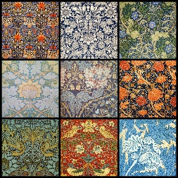
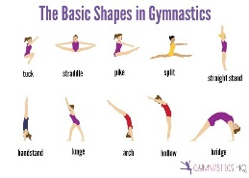
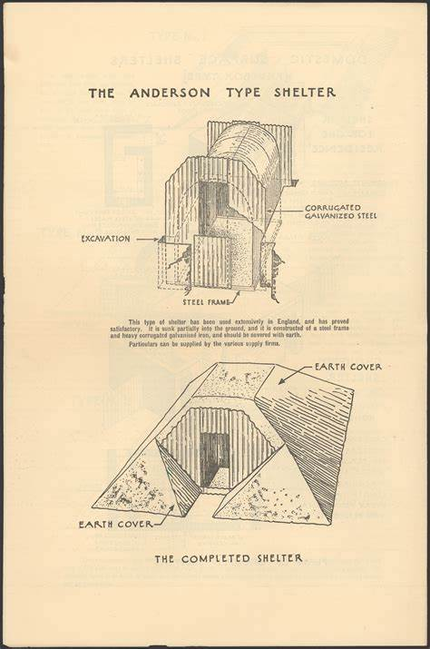
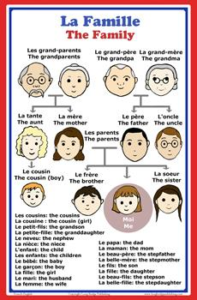
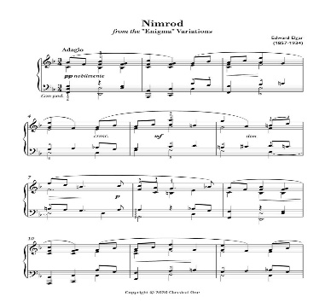
Knowledge Organiser – Autumn 2 2021, World War II Class 3
PSHE
What I should already know This is the first unit the children will have covered about ‘Rights’ as part of our Rights Respecting School approach. | The Journey To explore basic human rights and the rights of children. To discuss and debate the ideas of rights. To understand that not everybody’s rights are met.
Key Vocabulary Human Rights Declaration Entitled Universal Responsibility Consequences Rights respecting | What I will know by the end of the unit I will be able to explain that there are basic human rights that all people share and that these can’t be taken away. I will understand that children have their own rights
RE
What I should already know Why are festivals important to religious communities. Knowledge and understanding in our diverse community. | The Journey To generating big questions. Thinking about when they were younger and asked all sorts of questions that are difficult to answer e.g. Where does the sea end? Can they remember some they used to ask? Discuss how these questions can be difficult to answer because sometimes explanations are very complicated
Key Vocabulary Life Death Spiritual Belief Diverse Ultimate suffering | What I will know by the end of the unit I will be able to look for similarities and differences between my own views about life after death and the beliefs of Hindus, Christians, Muslims or non-religious people
Art
What I should already know To create sketch books to record their observations and use them to review and revisit ideas Artists around the world Pointillism – George Seurat Van Gogh | The Journey To understand who William Morris was –what he did and achieved and the era he lived in. To be able to have a go at sketching and repeating patterns- to create printing blocks Evaluate art work
Key Vocabulary Reflect Evaluate Repeating patterns Overlays | What will I know at the end of the unit I will be able to talk about William Morris’ life. I will be able to create artwork in the style of William Morris and evaluate my own and other works.
Music
What I should already know Played and performed in solo and ensemble contexts, using their voices and playing musical instruments with increasing accuracy, fluency, control and expression They have started to use and understand a stave and other musical notations. | The Journey To play a range of percussion instruments and keyboards. Record their compositions on a stave. To listen to and respond to music by Elgar – Nimrod. Learn and perform some WWII songs What I will know by the end of the unit Sing/learn songs and improvise and learn notes on a keyboard Key Vocabulary Improvise Keyboard Percussion Blues/scale
Design Technology
What I should already know How to join and strengthen different materials. How to evaluate products. The design and make procedure. | The Journey From our History topic we will investigate Anderson Shelters, looking at designs, materials and durability. We will design and then make an Anderson Shelter using junk modelling.
Key Vocabulary Artefacts Modelling Anderson Evaluate Design | What I will know by the end of the unit How to make and adapt from junk modelling-evaluate and discuss with peers how to make better and take on ideas from others.
PE
Key skills Gymnastics – Linking movements, flexibility and strength. Jumping, landing, rolling, balancing and weight bearing on different body parts. Basic Gym shapes. Multi-sports (Quidditch) – Use of space, moving with a ball, attacking, defending, team work, throwing and catching, warming up and cooling down, evaluation
MFL
Key Phrases – family words, animal names, home words, household objects mon/ma/mes [my] son/sa/ses [his/her/its] famille (f) [family] femme (f) [wife] fille (f) [daughter] fils (m) [son] enfant (m/f) [child].

Slide 3
Topic 20 Quiz Autumn 2021– WWII Class 3
Geography/History
What does Evacuation mean in relation to WW2? What date did Britain declare War on Germany? What was the cause of WW2? How were evacuees transported? What counties and in what part of England were children evacuated to?
PSHE
Can you list 3 Human Rights?
RE
What do some people think carries on after we have died? Will people behave differently in life if they believe in reincarnation? Why?
Music
What type of music was played during WW2? What type of music did Elgar write? Name one of his compositions? How does the style of dancing compare with today's style?
Computing
What does edit calculate data mean? What would you use a spreadsheet for? What would this formula do? =SUM(A2:A6)
Science
Why did Linnaeus create a system of classification? At which stage would you expect to see an animal classified as a mammal? Why were more levels added to the classification system?
Art and Design/ Design Technology
What sort of artist is William Morris? How are William Morris’ designs used today? Describe one technique you used to create your Anderson shelter.
Vocabulary – define these words
Evacuate Mammal Belief Boogie-Woogie Classify

