Slide 1
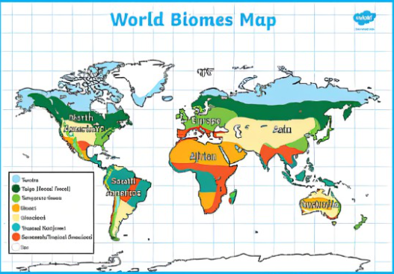
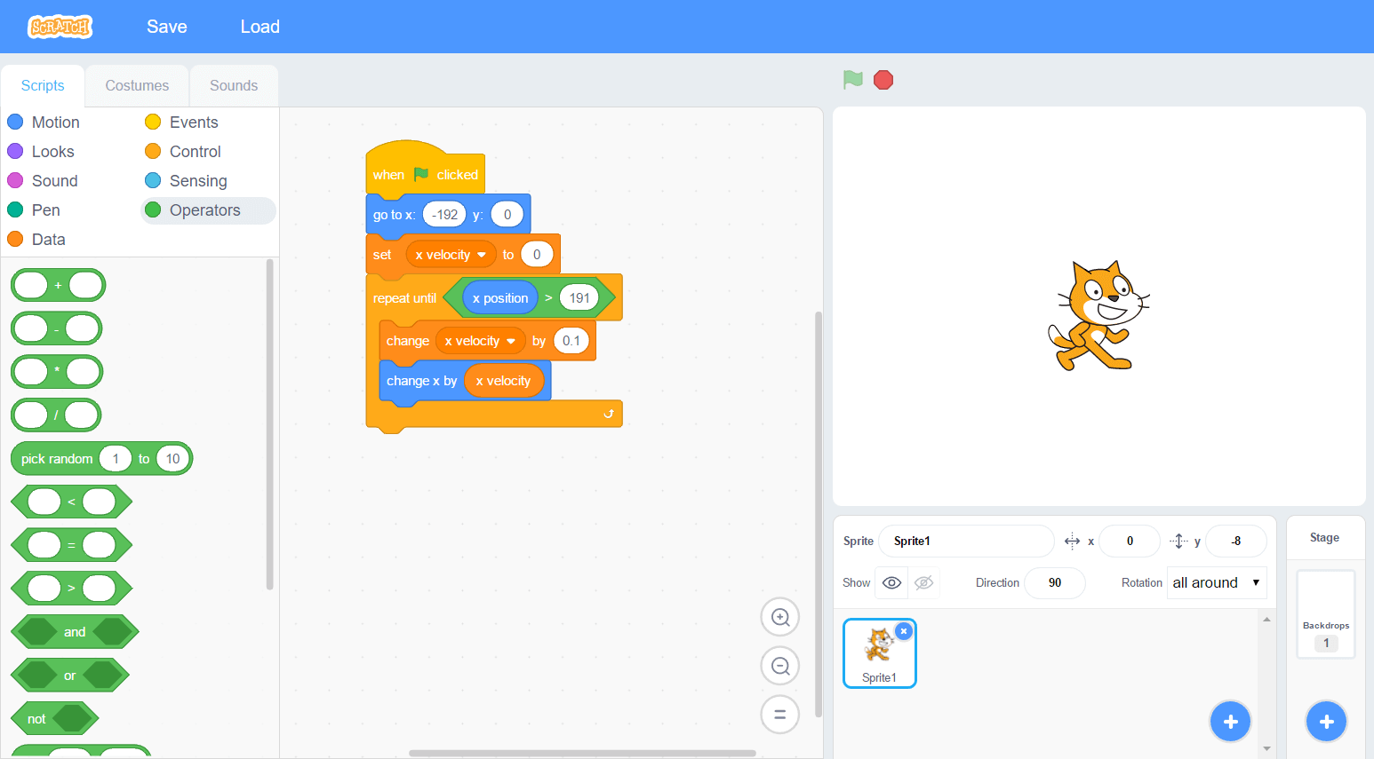
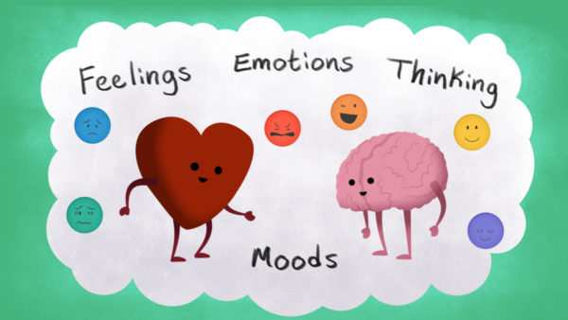
Knowledge Organiser – Spring 1 2022, Mad Science Class 3
Geography
What I should already know I can use maps, atlases, globes and digital/computer mapping to locate countries and describe features I can use the eight points of a compass, four and six-figure grid references, symbols and keys | The Journey Describe and understand key aspects of climate zones, biomes and vegetation belts. Use and label maps to locate biomes and key features of different biomes.
Key Vocabulary Ecological Biome Photosynthesis Vegetation Indigenous | What I will know by the end of the unit Understand the term ‘biome’ and identify biomes of the world , including vegetation, wildlife and climate identify indigenous peoples Using research, role-play .Understand the water cycle Understand how biomes need the right conditions to generate growth – light, heat and food Gain an understanding of photosynthesis
Computing
What I should already know Using the internet for research Creating documents – graphics, text and movies to present the information. Inventions | The Journey Select, use and combine a variety of software to design and create a range of programs, systems and content that accomplish given goals, including collecting, analysing, evaluating and presenting data and information.
Key Vocabulary Product Launch Market research Promote Evaluate, Present | What I will know by the end of the unit I will be able to create a game from my own design and create an advert to promote my game.
Science
What I should already know I can work scientifically through different topics and work on scientific enquiries. I have carried out some experiments and investigations and I can make predictions. | The Journey Planning different types of scientific enquiries to answer questions, including recognising and controlling variables where necessary Using test results to make predictions to set up further comparative and fair tests
Key Vocabulary Suited/suitable Environment Adaptation Characteristics Vary/variation Inherit/inheritance, Natural selection Evidenced enquiry scientific explanation | What I will know by the end of the unit I will report and present findings from enquiries, including conclusions, causal relationships and explanations of and degree of trust in results, in oral and written forms such as displays and other presentations. Identifying scientific evidence that has been used to support or refute ideas or arguments
PSHE
What I should already know I can identify my emotions and talk about some feelings with a trusted person. I can use mindfulness strategies to manage my emotional visitors. | The Journey Deepening their understanding of good and not-so-good feelings, to extend their vocabulary to enable them to explain both the range and intensity of their feelings to others.
Key Vocabulary Cognitive triangle Impact of positive thinking Facing your feelings Choices and consequences Mindfulness Growth mindset | What I will know by the end of the unit I will be able to describe some more feelings and how my feelings influence my behaviour I can talk about a range and intensity of my feelings I can name some strategies to deal with emotional visitors. I can appreciate how making good choices can make us happy;

Slide 2
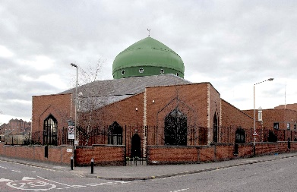
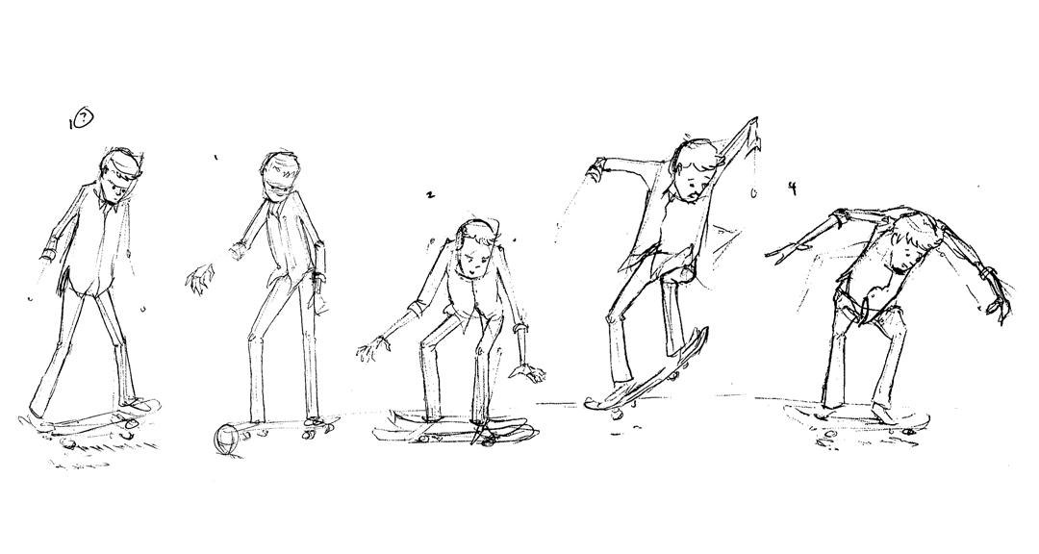
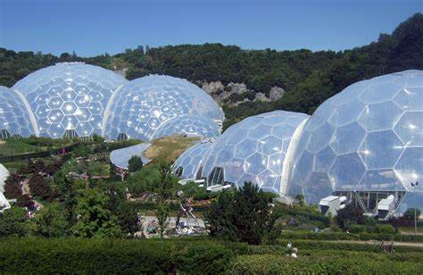
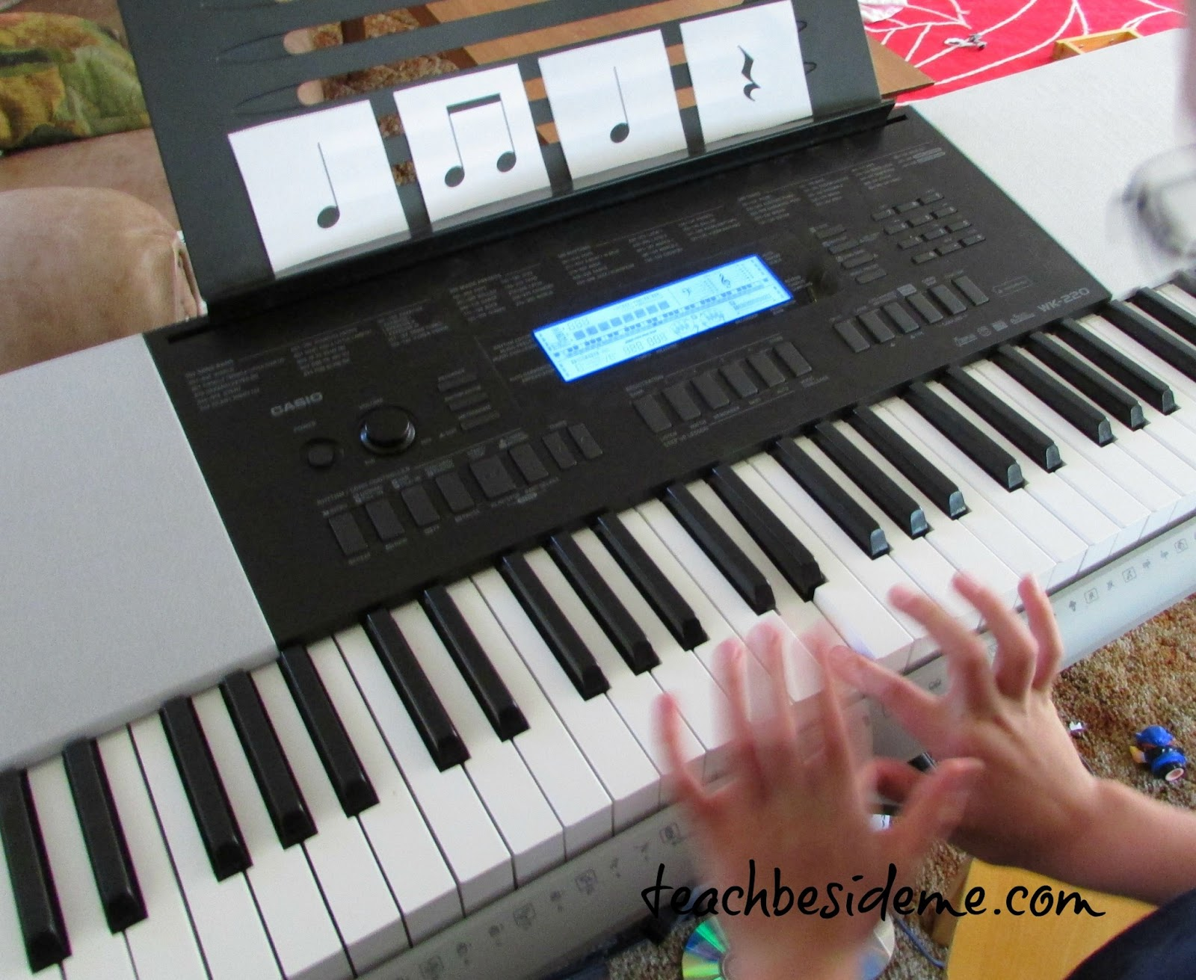
Knowledge Organiser – Spring 1, Mad Science Class 3
RE
What I should already know What can we learn from religions about right and wrong? I have looked at different religious buildings. | The Journey How can people express the spiritual through the arts? Share big question Find out about places of worship - Mosque. Research Mosques and the architecture within a mosque.
Key Vocabulary Choice Connection Debate Empathise Develop Creativity Generosity Charitable Architecture | What I will know by the end of the unit Respond with ideas of my own about how arts are used in religion – particularly Islam I will know about religious teachings, charities and ways of expressing generosity within Islam
Art
What I should already know I have worked with different art media to create pictures I have sketched and developed portrait drawings | The Journey Questioning and make thoughtful observations about starting points for their work. Select and record from first-hand observation and to explore ideas for different purposes.
Key Vocabulary Create Shape Motion Figure Purpose Technique process | What will I know at the end of the unit I will have improved my art and design techniques, particularly drawing and sketching with a range of materials [for example, pencil, charcoal, paint,
Music
What I should already know I have performed in class, assembly singing and whole school events such as Harvest and Christmas Key Vocabulary Compose, Perform Ensemble, Fluency, Accuracy | The Journey I will be working with the music specialist to compose and perform using my voice, keyboard and percussion instruments. What I will know by the end of the unit Be able to improvise and compose music for performance to my class and Mrs Litchfield
Design Technology
What I should already know I have worked with different materials to create basic models for example an Anderson Shelter. I have worked with a range of different art media to finish a piece of work. | The Journey From our Geography work we will create an Eden project using recycled materials. We will explore joining and finishing techniques.
Key Vocabulary Design Technique Examine Recycle Join Product Bio degradable | What I will know by the end of the unit I will be able to link my knowledge of the Eden Centre to create a model. I will be able to join materials to make it stronger. I will be able to follow my design
PE
Key skills Dance with Louise- correlation to some of the music unit. Develop different ways of travelling, jumping and turning Perform the basic actions and dances clearly and fluently Work with a partner and group Observe themselves and others dancing
MFL
I will learn how to: Tell the time: o’clock, half past, quarter past, quarter to and 5-minute intervals. Use 24-hour times and the way in which the French represent a.m. and p.m. times. Use airport arrival and departure boards and a school timetable to consolidate the skills learned in French.

Slide 3
Topic 20 Quiz Spring 1 Mad Science Class 3
Geography/History
What is a Biome? Can you name some of the world’s biomes? What are climate Zones? What do climate, vegetation and animals all have in common? What is an indigenous person?
PSHE
How do we recognise conflicting emotions? Why is it important to make the right choices?
RE
What does it mean to make a building ‘for the glory of God’? Can you describe a feature of a Mosque?
Vocabulary – define these words
DNA Indigenous Climate Vegetation belt Disease
Music
What aspects of rhythm are there? How do we create dance moves-what must we do when working in a dance group? How many notes in an octave?
Science
Why do Foxes come in so many different versions? What is DNA made up of? How do we treat different diseases? How do ensure you carry out a ‘Fair Test’?
Computing
How do computer game companies decide what type of games people will like? What is debugging?
Art and Design/ Design Technology
What techniques and methods can you use to show movement when sketching? What technique could you use to make a model stronger?

