Slide 1
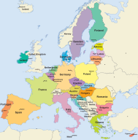
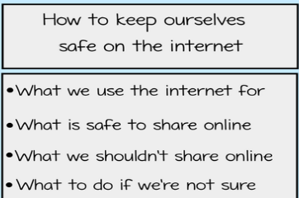
Knowledge Organiser – Autumn 1 2021, European Adventure, Class 2
Geography
What I should already know How to use world maps, atlases and globes to identify the United Kingdom and its countries | The Journey To locate the world’s countries, using maps to focus on Europe To describe and understand key aspects of physical geography including rivers and mountains To use maps, atlases and digital mapping To describe and understand key aspects of physical geography including climate zones, rivers and mountains To describe and understand key aspects of physical and human geography
Key Vocabulary | What I will know by the end of the unit How to locate the world’s countries, using maps to focus on Europe How to identify the key European physical features The European capital cities in each country How to examine the weather from each of Europe’s climate zones before making a decision what clothes to pack if you were to go on holiday!
Mountains | Europe | Atlas
Digital mapping | Climate zones | Human Geography
Physical Geography | Locations | Countries
Science
What I should already know How to observations and ideas to suggest answers to questions To perform simple tests Ask simple questions and recognise that they can be answered in different ways | The Journey To investigate what we need in order to see objects in a dark place and discover how light travels To notice that light is reflected from surfaces To investigate how light is reflected by different surfaces To recognise that shadows are formed when the light from a light source is blocked by an opaque object To investigate how shadows change as the light source is moved To create a shadow puppet performance
Key Vocabulary | What I will know by the end of the unit
Computing
What I should already know How to use technology safely and respectfully To keep personal information safe Where to go for help and support if I have concerns about content or contact on the internet or other online technology. | The Journey To learn how to protect myself online To understand how to be internet secure To learn how to be internet sharp To know what cyberbullying is and how to address it To explore different ways children can communicate online To understand how websites use advertisements to promote products
Key Vocabulary | What I will know by the end of the unit
Light | Opaque | Transparent
Translucent | Reflect | Light source
Ray | Dark | Shadow
Digital footprint | Privacy | Browser
Protect | Cyberbullying | Social media
Social networks | Digital | Device

Slide 2
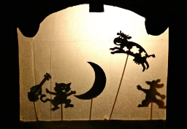
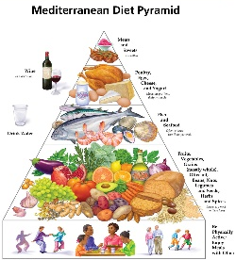
PSHE
What I should already know How family lives differ How homes may look different depending on where we live and in different parts of the world How schools differ around the world Different environments | The Journey To discuss ways in which peoples lives are similar and different To recognise and challenge stereotypes To think about the lives of people living in other places To explain what climate change is and how it affects peoples lives and what I can do to help To identify different organisations which help people in different countries who are in challenging situations
Key Vocabulary Cultural, ethnic, racial, religious diversity, age, gender identity, disability, climate change | What I will know by the end of the unit That people’s life experiences and opportunities differ throughout the world
RE
What I should already know The religious beliefs of Christianity Where Christians go to worship The religious symbols for the main religions around the world | The Journey To explain the main beliefs held by Buddhists To explain which places are special for Buddhists To explore the main beliefs in Sikhism To explain what makes the Gurdwara a special place for Sikhs To explain the main beliefs of Christianity
Key Vocabulary Buddhism, Sikhism, Christianity, Religion, Worship | What I will know by the end of the unit To compare the main beliefs of Buddhism, Sikhism and Christianity
Art
What I should already know To use a range of materials creatively to design and make products | The Journey To introduce shadow puppets and plan a performance To design and create a stage set To design and create shadow puppets To write a play script to perform a shadow puppet play
Key Vocabulary Design, technique, material, transparent, opaque, texture | What I will know by the end of the unit Design, make and evaluate a shadow puppet performance
Knowledge Organiser – Autumn 1 2021, Class 2
Music
What I should already know How to play tuned and untuned instruments musically How to use your voice expressively and creatively by singing songs and speaking chants and rhyms | The Journey To play and perform in solo and ensemble contexts To play musical instruments and use your voices with increasing accuracy, fluency, control and expression
Key Vocabulary Rhythm, singing, music stimulus, music appreciation, accuracy, fluency, control, expression | What I will know by the end of the unit How to use and understand staff and other musical notations
Design Technology
What I should already know How to prepare and make a range of healthy dishes | The Journey To understand and apply the principles of a healthy and varied diet To prepare and cook a variety of Mediterranean savoury dishes To understand seasonality, and know where and how a variety of ingredients are drown, reared, caught and processed
Key Vocabulary Mediterranean diets, nutrition, balanced diet, healthy eating, recipes, seasonality, | What I will know by the end of the unit The ingredients and health benefits of a mediterrean diet
MFL
Key Phrases mon [my], ton [your], anniversaire (m) [birthday], la date (f) [date], premier (m) [first] ‘Comment ça va? – How are you? Les passe-temps (m) [Hobbies] Tu aimes…?- Do you like…? J’aime…[I like…] J’adore…[I love…] Je n’aime pas… [I don’t like…] Je deteste… [I hate…] C’est de quelle couleur? [What colour is it?], bleu [blue], blanc [white], rouge [red], noir [black], jaune [yellow], vert [green], gris [grey], orange [orange], rose [pink], violet [purple], marron [chestnut brown], C’est… [It’s…].
PE
Key skills Developing: stamina, speed, strength, sending, receiving dribbling, control, travelling

