Slide 1
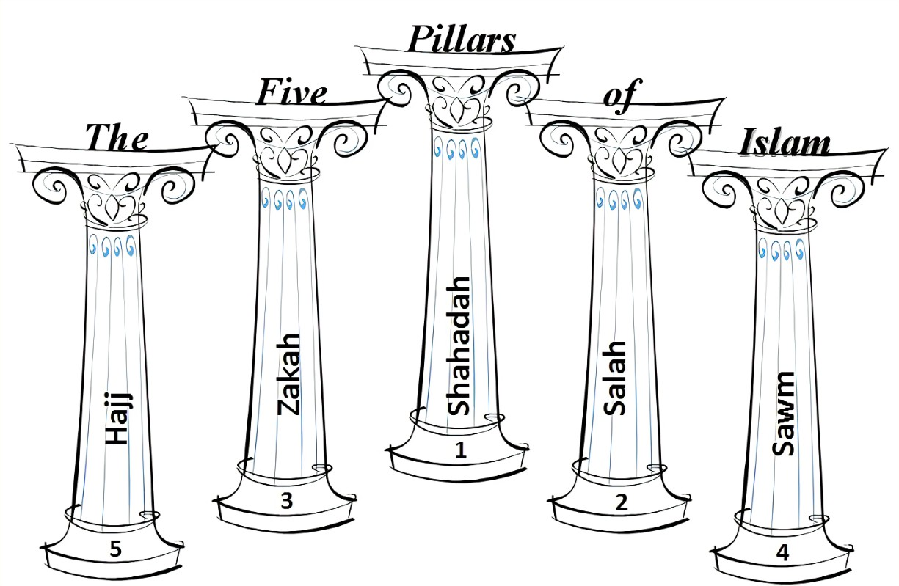
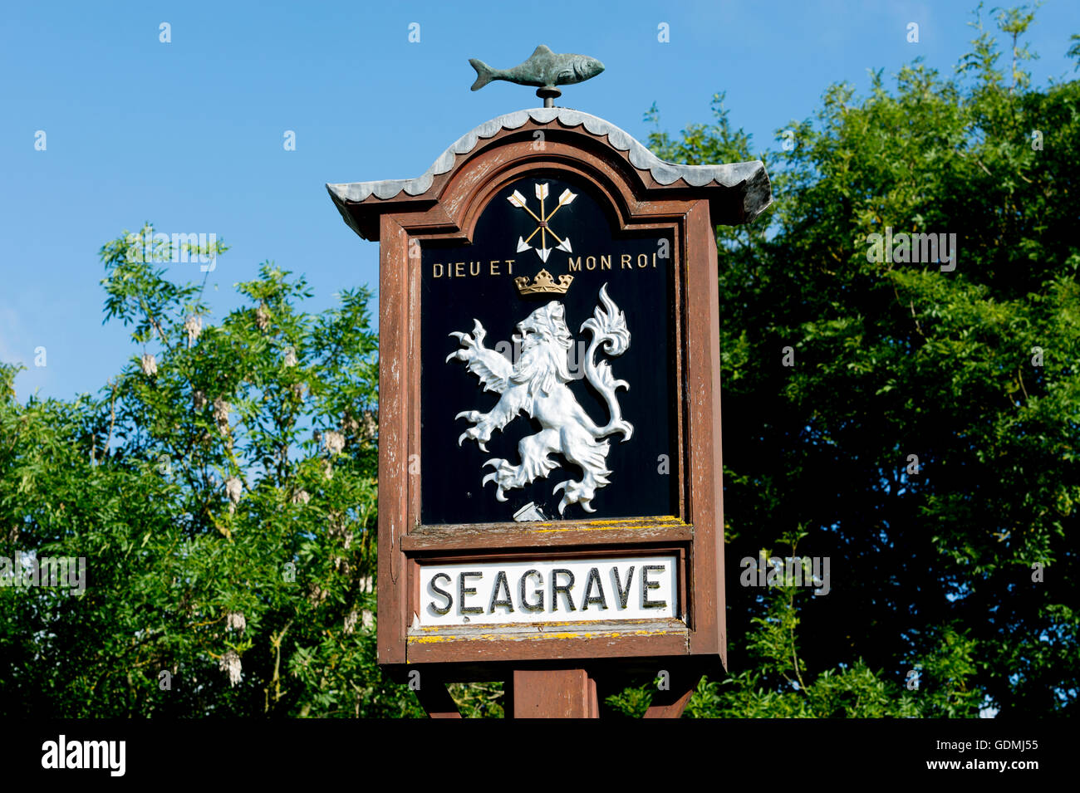
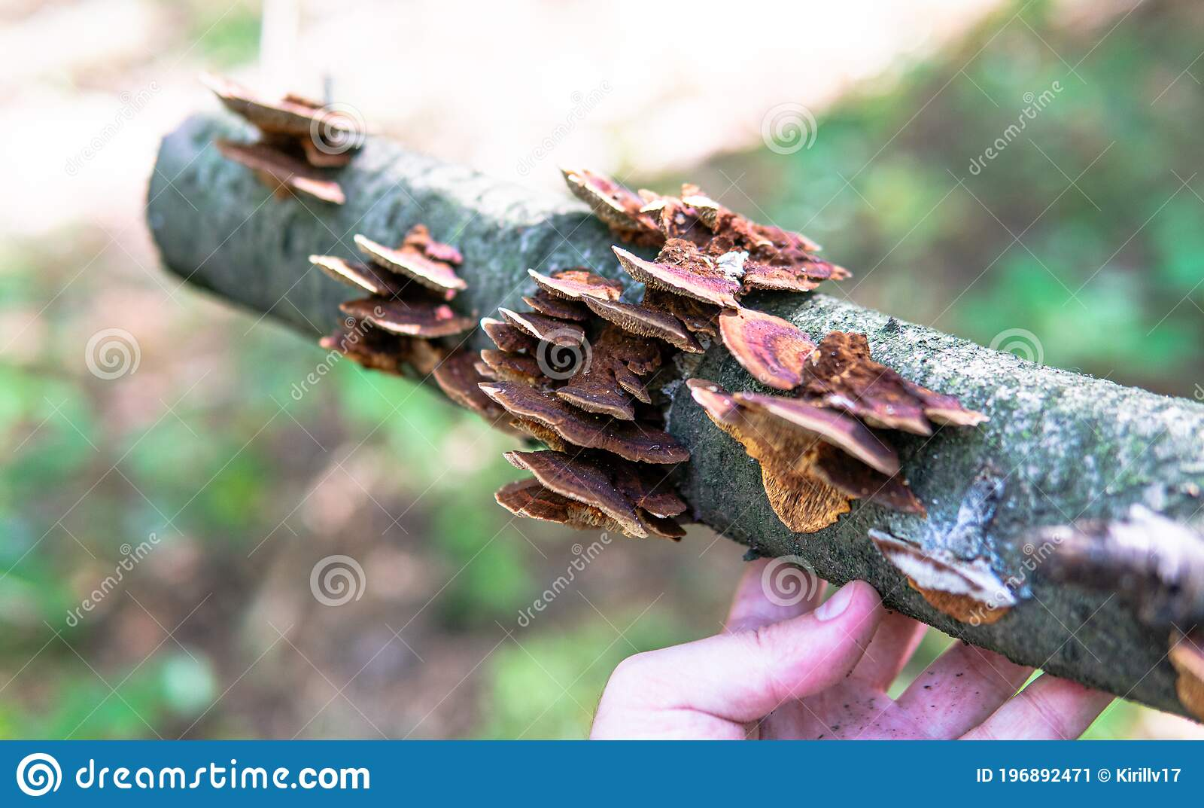
Knowledge Organiser – Spring 1 Mad Science Class 3
Geography
What should I already Know Local study in class 2 looked at Seagrave on OS maps and field work within Seagrave. Comparison between Seagrave and larger towns | The Journey To look at Seagrave’s location in relation to the wider world. To compare and contrast localities – within Leicestershire and beyond (rural and urban). Identify key physical and human geography within the locality and beyond. To present their findings in a variety of ways including digitally.
Key Vocabulary Rural Urban Locality Physical and human geography | What I will know by the end of the unit I will be able to use fieldwork to observe, measure, record and present the human and physical features in the local area using a range of methods, including sketch maps, plans and graphs, and digital technologies
RE
What I should already know Belief about God in Christianity Hinduism Islam Similarities and differences between different religions | The journey To go through a series of learning starting with understanding what the Qur’an is. Developing this by looking weekly at the 5 pillars of Islam and what they mean to this faith and every day life.
Key Vocabulary Qur’an 5 Pillars Mount Arafat Pilgrimage Fasting | What I will know by the end of the unit I will know more about more about the Islamic faith in greater depth and the beliefs and way of life that the Islamic faith teaches
Science
What I should already know ‘Living Things and Their Habitats’ unit covered in year 4 Basic understanding of micro-organisms. | The Journey To understand our local habitat linking this topic linked with forest schools. Understanding where Fungi is and the different types . Going on walks and discovering what it grows on and how it develops. Creating a fact file.
Key Vocabulary Fungi Mushroom Mould Scientific investigations | What I will know by the end of the unit I will be aware of different types of Fungi and where they grow I will know about common mushrooms/toadstools are and be aware that they might be poisonous Investigate fungi in an experiment –hypothesising and using a scientific investigative approach
Computing
What I should already know To use software (including the internet) on a range of digital devices to design and create a range of programs, systems and content – movie maker Safe use of the internet | The Journey Children will learn how to create short videos by working in pairs or groups. As they progress through this unit, they will use topic-based language and develop the skills of capturing, editing, and manipulating video.
Key Vocabulary Production Edit Technique Digital | What will I know at the end of the unit PowerPoint Embed sound Embed video Set timings Transitions/design – effectiveness Movie Maker - Manipulate and edit recorded video to suit a specific purpose

Slide 2
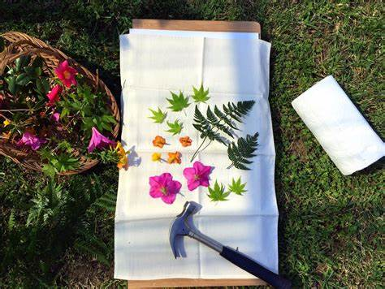
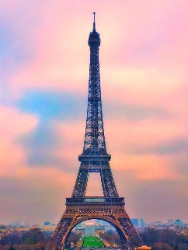
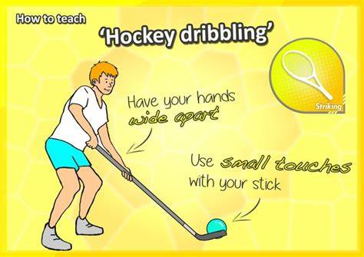
PSHE
What I should already know We have an awareness of growth mindset or the attitudes and behaviours that support learning. | The Journey In this unit of work, children will focus on achievements, aspirations and opportunities. They will start by discussing achievements they have accomplished so far and the type of attitude that helps us succeed. They will also learn about their own personal preferred learning styles, to understand how they learn best.
Key Vocabulary Achievement Mindset Determination Attitude Perseverance | What I will know by the end of the unit I will be able to identify personal strengths, skills, achievements and interests and how these contribute to a sense of self-worth.
Art
What I should already know Experience of recording, improving drawing, clay and painting using different medias. Study of famous artists. | The Journey The children will use pencil, colour, Hapa Zome printing, sculpture and paper modelling to create quality art work that shows progression in their skills. The children will also have the opportunity to explore the work of India Flint, Alexander Calder, David Oliveira.
Key Vocabulary Texture Pattern Form Structure Hapa-zome Hammering Dye | What I will know by the end of the unit I will have improved my art and design techniques, including drawing, painting and sculpture with a range of materials.
Knowledge Organiser Spring 1 Mad Science Class 3
Music
What I should already know Have an awareness of musical instruments the playing of and notation | The Journey Music development through the ages looking at a time line and discovering the unique genres learning styles of music and composers.
Key Vocabulary Baroque Romantic Classical Modern | What I will know at the end of the unit To be able to identify different composers from different time period
MFL
Key Phrases la tour Eiffel l’Arc de Triomphe le Louvre la cathédrale Notre-Dame la Seine le stade de France le Sacré-Cœur l’avenue des Champs-Élysées le Jardin des Tuileries
PE
Key skills Hockey Dribbling, strike and stop, Push pass, Block tackle, Shooting, reverse sweep, flicks and game play Dance Perform a series of dance movements Link dance movements Perform dance moves linked to different eras Perform in unison

Slide 3
Topic 20 Quiz MAD SCIENCE
Geography/History
Describe a physical feature in Seagrave
Describe a human feature in Seagrave
List 3 differences between rural and urban places
PSHE
How do people learn new things and achieve certain goals?
How does it help to have a good attitude towards learning?
RE
What are the 5 Pillars of Islam?
Explain what Hajj is?
Science
Name a place where fungi might grow
Explain what a hypothesis is
Music
What type of music is Renaissance?
Which time/genre was Handel in?
MFL
Write this sentence in French I would go to Paris to see the Eiffel tower.
Computing
What is a story board and what does it include?
Art and Design/ Design Technology
Why is detail and colour important?
Who was India Flint?
What is a Hapa-Zome?
Vocabulary – define these words
Urban
Dribbling (Hockey)
Perseverance

