Slide 1
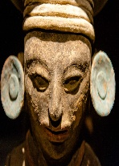
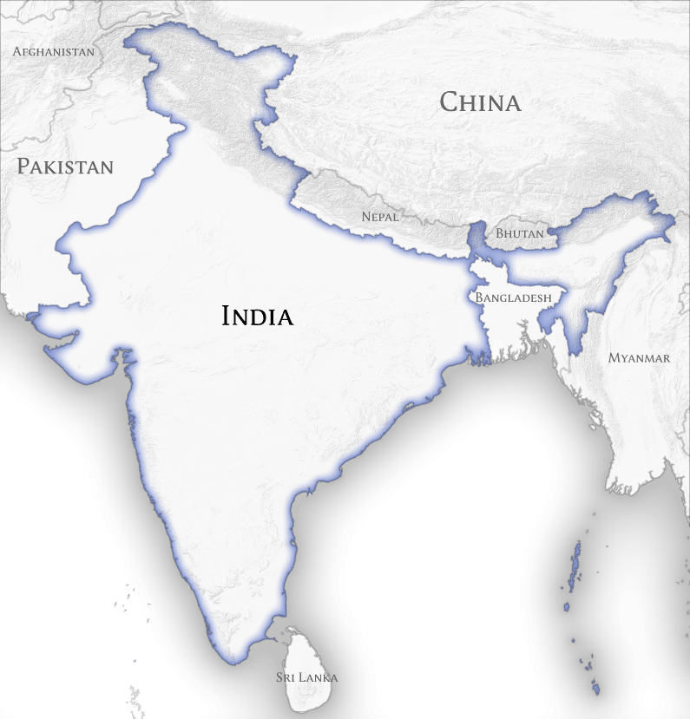
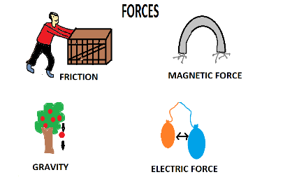
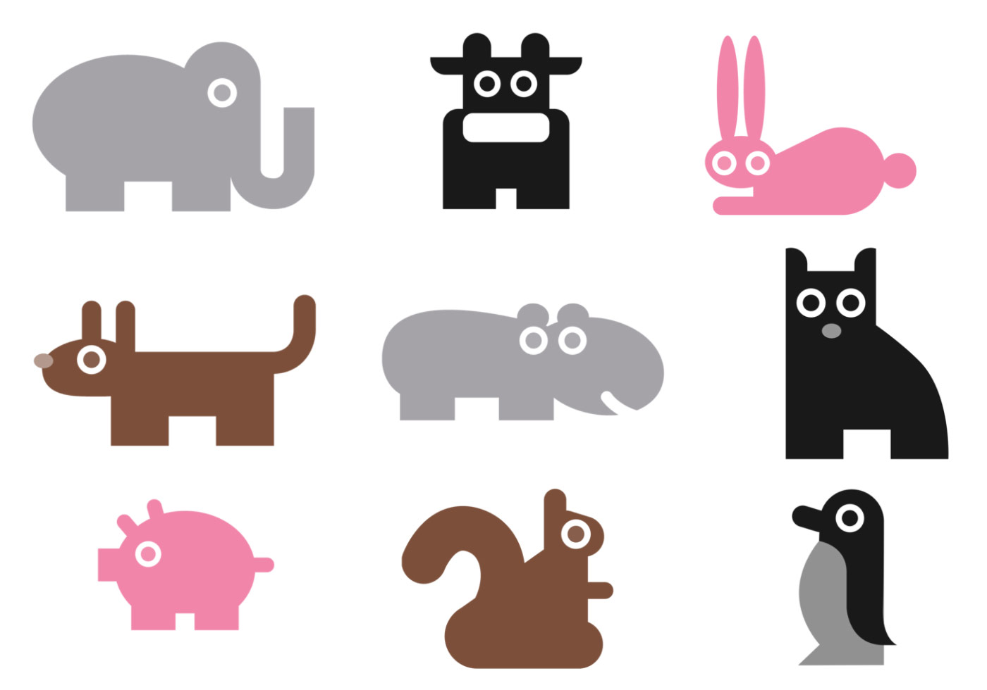
Knowledge Organiser – Spring 2 Class 3 - INDIA
Geography
What should I already know Be able to describe and understand key aspects of physical geography: climate zones, biomes and vegetation belts, rivers, mountains, volcanoes and earthquakes, and the water cycle. | The Journey To develop our understanding of India through atlas work-maps and research. Identify main cities in India Use their knowledge to produce a 2- page information text.
Key Vocabulary New Delhi Mumbai Chennai Bangalore Hyderabad | What I will know by the end of the unit I will be able to construct a physical map of India, outline main cities on map of India Produce a mind map about India’s connection to the UK I will be able to organise my knowledge and present it for sharing with class 2
History
What should I already know Other ancient civilisation to make comparisons Greeks Romans | The Journey The children will learn who the ancient Maya people were, where and when they lived. They will use researching techniques to learn facts and answer questions. They will understand the links between Mayan life and Indian life
Key Vocabulary Civilisation Sacrifice Worship Bloodletting Ritual Xibalba Upper world | What I will know by the end of the unit They will use maps and atlases to locate Maya cities and identify countries in Mesoamerica. They will learn about the religious beliefs and rituals of the ancient Maya people and find out more about some of the many gods they worshipped. The children will also learn about the Maya number system.
Science
What I should already know Electricity and forces. | The Journey To use retrieval and think about what you already know through KS1 and class 2 To discuss and think about different forces and investigate them. Looking at air resistance and gravity. Making a parachute and thinking about the rate of fall. Use a range of scientific equipment, with increasing accuracy and precision, taking repeat readings when appropriate recording data and results of increasing complexity
Key Vocabulary Friction Air resistance Surface area Drag Gravity Push Pull Force | What I will know by the end of the unit To know that there are many different forces and familiarise ourselves with the vocabulary. To know that air resistance is a force that slows moving objects. To know that the smaller the surface area the less the amount of air resistance and the faster the rate of fall. To understand the effect of streamlining on air resistance.
Computing
What I should already know Safe use of the internet Internet research Embed sound Embed video Set timing Transitions/design – effectiveness | The Journey We will introduce vector drawings and begin to understand that they are made up of simple shapes and lines. We will use the main drawing tools within the Google Drawings application to create their own vector drawings – including manipulation and layering. We will discuss how vector drawings differ from paper-based drawings.
Key Vocabulary Vector Drawing tools Object Toolbar Manipulate Layer | What will I know at the end of the unit How to create vector drawing, use different drawing tools to help create images. I will be able to talk about and demonstrate how images in vector drawings are created using shapes and lines. I will be able to talk about each individual element in the drawing as an object.

Slide 2
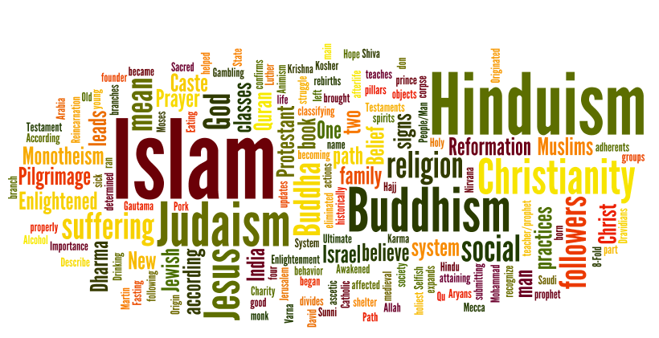
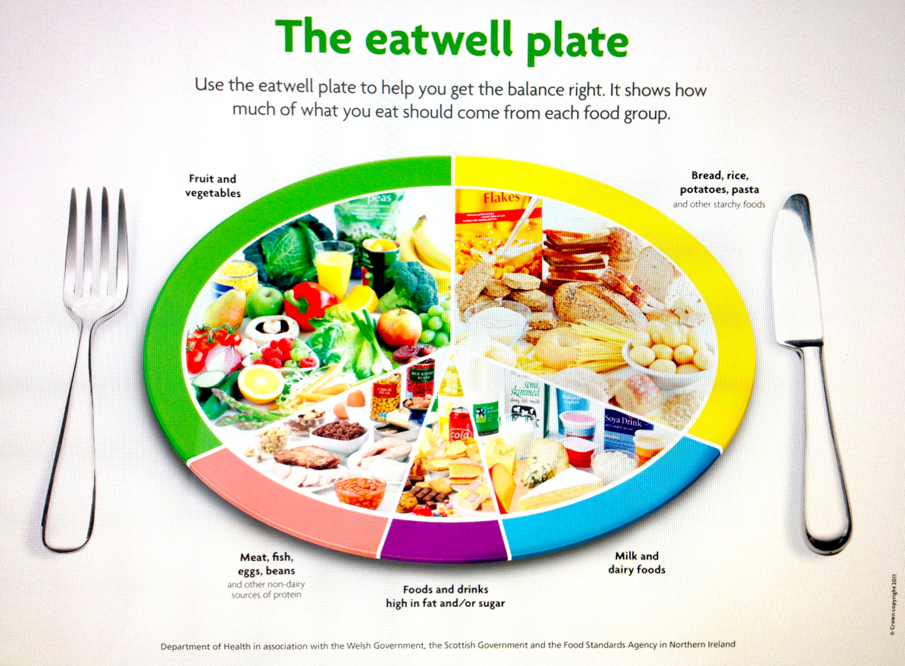
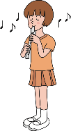
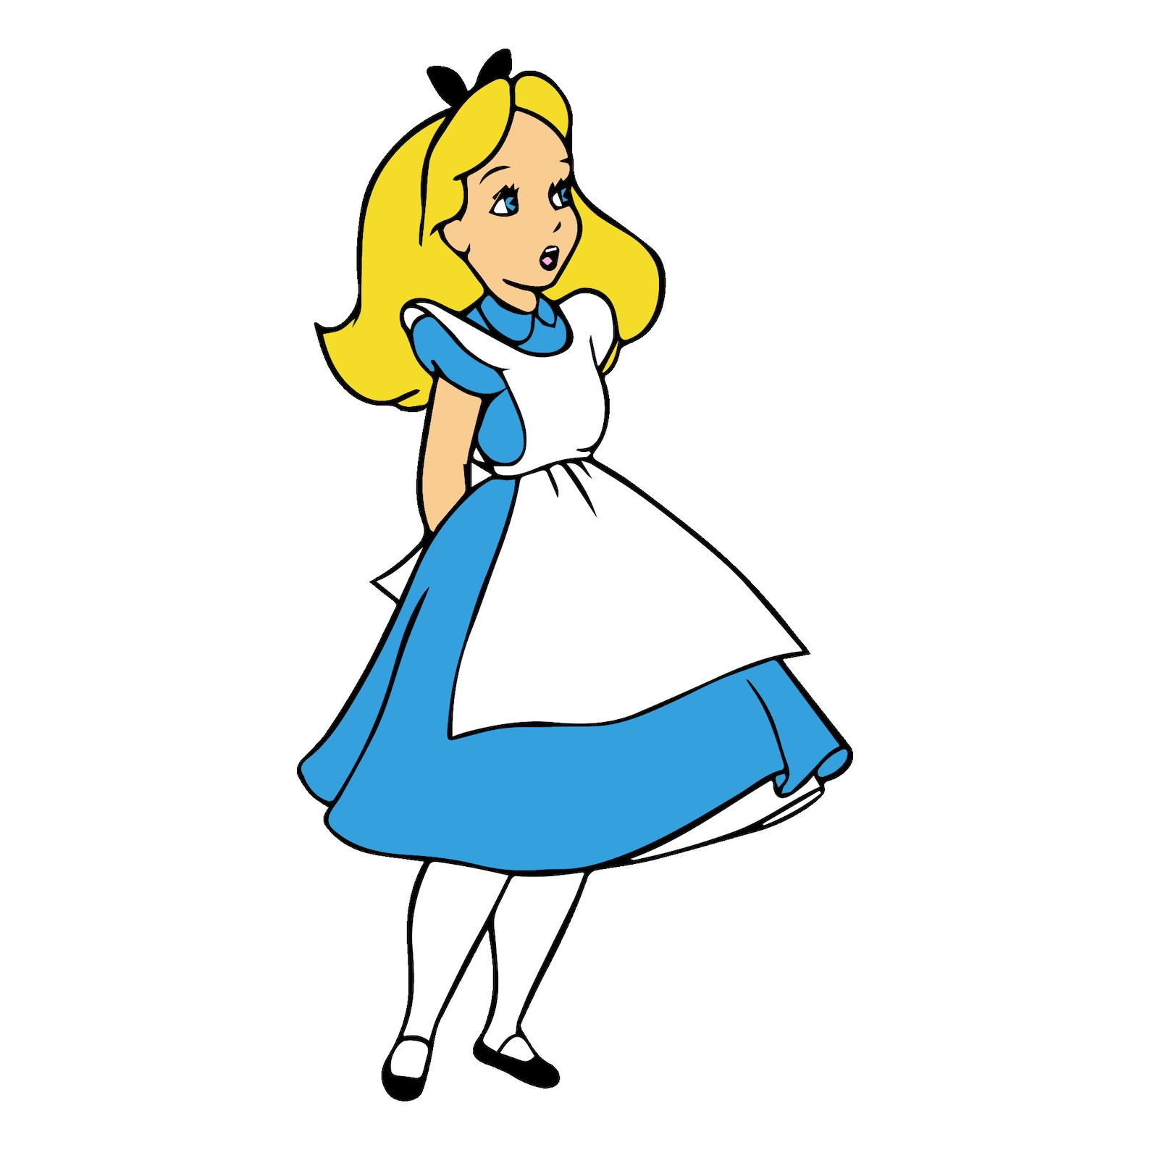
Knowledge Organiser – Spring 2 Class 3 - INDIA
PSHE
What I should already know We have talked about money within maths lessons. We have differing experiences of money from their homelives. | The Journey Children will explore how to see the real value of products by being critical consumers and also consider influences that advertisers try to use to encourage people to spend money and ways we can spend money; children will learn about budgeting and will discuss how people may choose or need to prioritise spending. Look at impact money can have on people’s emotional wellbeing.
Key Vocabular money, investment, gain, interest, risk, bankrupt, inflation, value, scam, steal, gamble, profit, save, future | What I will know by the end of the unit Talk about what financial risk is. discuss the ways advertisers try to influence consumers. Describe what ‘value for money’ means. Talk about what it means to budget.
RE
What I should already know Big questions What do religions say when life gets hard? Define atheist/agnostic/theist Valuing good and debating and questioning | The journey To be diving deeper with upper KS2 children using discussion evidence and them starting to form their own opinions. To be able to succinctly debate showing a clear understanding of their opinions with evidence from understanding the lessons to back views.
Key Vocabulary Suffering Sensitivity Debate Empathy | What I will know by the end of the unit To learn about the moral and religious issues to suffering and develop key words and terminology.
Music
What I should already know To play and perform in solo and ensemble contexts, using your voices and playing musical instruments with increasing accuracy, fluency, control and expression Key Vocabulary Recorder Descant Alto soprano | The Journey To understand traditions through the ages of the recorder. Research composers/performers. To play the recorder looking at technique and continuing to develop the reading of music and notation. To perform to the school in an assembly What I will know at the end of the unit To play a short piece together as a class with confident players soloing! Continue to develop our singing voices-stamina Alice Musical
Design Technology
What I should already know Cooking and nutrition Healthy diet Varied diet Seasonality | The Journey To consolidate and understand the different food groups. To consider a balanced diet. To think about good sugars and creating a healthy drink!
Key Vocabulary Balanced healthy Diet Natural Carbohydrates Fats Protein Dairy | What I will know by the end of the unit Food groups Healthy alternatives Design-Make-Evaluate a smoothie
PE
Key skills - Netball Passing, moving and to play within the footwork rule Defending Attacking Shooting/scoring goals
MFL
Days of the week Lundi - Monday . Mardi - Tuesday . Mercredi - Wednesday . Jeudi - Thursday . Vendredi - Friday . Samedi - Saturday . Dimanche – Sunday Months of the year janvier – January, février – February, mars – March, avril – April, mai – May, juin – June, juillet – July, aout – August, septembre – September, octobre – October, novembre – November, décembre – December
Notes:
Healthy’Natural

Slide 3
Topic 20 Quiz India
Geography/History
Write down three main cities in India What connection does India have to the UK and Maya?
PSHE
What is a consumer? What does it mean to balance a budget?
How do advertisers try to influence customers to buy?
Science
Can you name the different forces?
Air resistance is a force that shows what?
RE
What are the moral and religious issues to suffering?
Music
What are the three different sizes of the recorder called?
In which period did the recorder begin and develop? Who invented the recorder?
Art and Design/ Design Technology
Can you name the 7 different food groups?
What is a varied diet?
Vocabulary – define these words
Accuracy Precision Complexity Inflation Investment
Computing
What are vector drawings made up of?
Can you explain how alignment grids and resize handles can be used to improve consistency?

