Slide 1
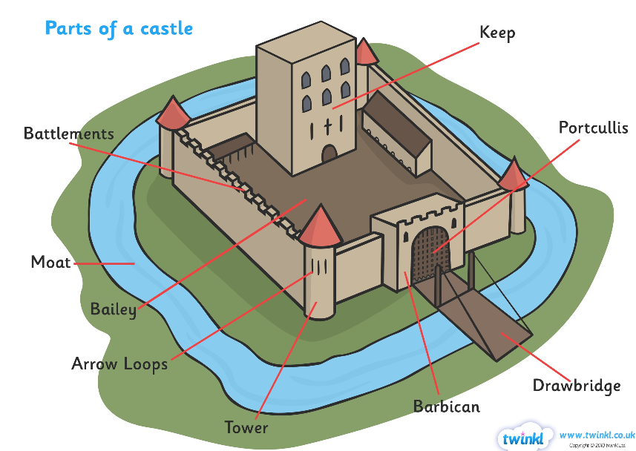
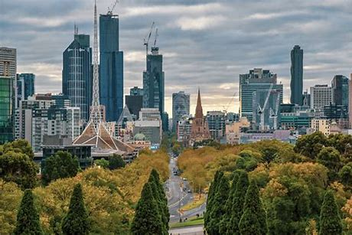
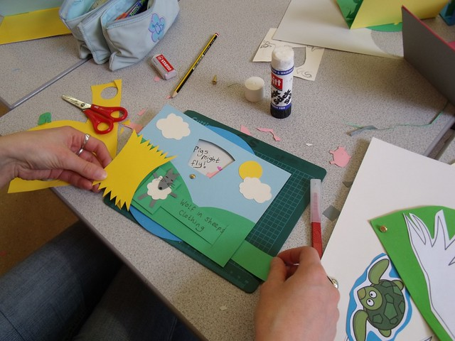
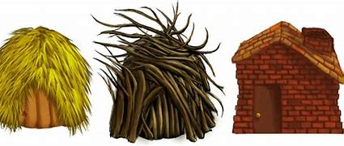
Geography
What I should already know Children are familiar with the term countryside and town. Children have a sense of their own locality. Children have experience of looking at ariel footage and are familiar with basic maps and atlas reading skills. | The Journey To compare and contrast rural and urban areas. Initially starting with Seagrave and Leicester and moving on to comparing rural and urban areas of Kenya. We will look at Atlases, aerial photographs, maps and photographs to look for similarities and differences between rural and urban areas.
Key Vocabulary Compare Contrast Similarities Differences Rural Urban Features landmarks | What I will know by the end of the unit The difference between a rural and urban area through understanding the features and landmarks typical of both. Experience of using a range or resources to aid research. Understand that rural and urban areas can look very differently in different countries compared to our local area.
History
What I should already know Children already know what a castle and some may have even visited one before. Children understand that castles are part of our British history. | The Journey Children will learn about different types of castles and their features through research and junk modelling. Children will discover what like was like living in a medieval castle. Children will learn about methods of attacking and defending a Motte and Bailey castle.
Key Vocabulary Bailey arrow loop Motte battlements Moat keep Drawbridge Medieval Portcullis | What I will know by the end of the unit Children will be able to label the features of a castle. Children will be able to talk about what life was life for people living and working in a medieval castle. Children will have made their own castle using a variety of junk modelling materials and can plan for methods of defence and attack.
Knowledge Organiser – Spring 1 Fairy-tales Class 1
Science
What I should already know The name of a variety of materials in the contexts of fabrics. Have experience of carrying out investigations and sorting/classifying activities. Children will have experience of talking about the properties of some materials such as hard/soft, flexible/rigid. | The Journey Children will explore a range of materials through sorting, classifying, investigating and discussing their properties. Children will make predictions on whether certain materials will be strong or not. Children will then explore the use of a variety of materials to create houses for the Three Little Pigs and say if the material is appropriate for the design criteria.
Key Vocabulary Investigation Sorting Classifying Identifying Materials Properties | What I will know by the end of the unit Children will be able to name a variety of different materials. Children will be able to sort objects according to their properties. Children will plan and create different houses with materials supplied and be able to talk about the properties of each material used and be able to say whether it is a good material for the job or not.
Design Technology
What I should already know How to use scissors confidently. Begin to manipulate materials to the desired effect. Have used lolly sticks before. | The Journey Children will explore the use of mechanisms to create a moving picture. The children will develop skills in creating sliders, levers and wheel mechanisms. Children will design, create and evaluate their own moving pictures incorporating some of the mechanisms practised in previous lessons.
Key Vocabulary Moving picture Mechanism Lever Slider Wheel mechanism materials | What I will know by the end of the unit Children will know how to design and create a variety of mechanisms in order to successfully design, make and evaluate their own moving picture to the design criteria. Children can name the different types of mechanisms modelled and practised throughout the unit.

Slide 2
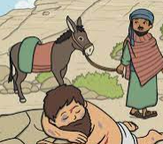
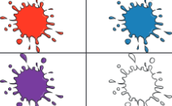
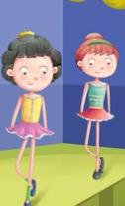
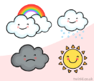
PSHE
What I should already know The children have already touched on positive attitudes towards friendships and participating in teams. | The Journey The children will learn the qualities which are needed to become positive learners. They will learn about setting goals which will given them bright futures. During this unit they will also learn about changes and the relationship between change and positive attitudes.
Key Vocabulary Goals Loss Attitude Positive Future Interests Skills Experiences Qualities | What I will know by the end of the unit In this unit of work, children will learn about having high aspirations. They will start by discussing positive views of themselves and will then identify how having a positive learning attitude can help them tackle and achieve new learning challenges and improve learning outcomes
RE
What I should already know The children should already know about different religions and being part of religious communities. They are already aware of the religion Christianity and the place of worship. All children have been to the church and know about key stories such as the birth of Jesus and the Easter story. | The Journey The children will hear different stories through the unit and will reflect on the messages which Jesus was trying to send to his followers. The children will be completing role play and storyboard retellings of each story, using accurate vocabulary.
Key Vocabulary Samaritan Parables Morel Jesus Bible Sower | What I will know by the end of the unit They will know the importance of parables in the Bible and the messages which Jesus was sending to his followers through the parables.
Art
What I should already know The children should already know how to create simple collages by layering materials. They already know about creating textures using different materials. | The Journey The children will be using different materials to create different elements of a collage. The children will then be attaching the different parts to create an overall piece of art using the collaging technique.
Key Vocabulary Texture Collage Soft Bumpy Rough Uneven Smooth Glossy | What I will know by the end of the unit The children will know the correct materials and tools which are used to create textures. They will know how to attach different parts to create an overall collage piece of work.
Knowledge Organiser – Spring 1 Fairy-tales Class 1
MFL
Key Phrases Jaune Rose Gris Blanc La piscine Le stade Le café La neige L’orage Le vent Le soleil
Music
What I should already know Children already have experience of listening to music from a variety of genre. Children have responded to music using movement and expressed likes and dislikes for a piece of music. | The Journey The children will listen to a variety of music genre and learn to respond to music in a variety of different ways such as movement, art, expressing feelings and discussing likes and dislikes,
Key Vocabulary Genre Movement Likes Dislike Emotion Opinion Respond | What I will know by the end of the unit Children will have listened to a variety of different music genre and are able to confidently respond to the music in a variety of different ways.
Computing
What I should already know The children have played programming games on IPADs and have explored Beebots independently during provisional learning. The children have created oral programming algorithms. | The Journey Learners will explore using individual commands, both with other learners and as part of a computer program. They will identify what each floor robot command does and use that knowledge to start predicting the outcome of programs.
Key Vocabulary Algorithm Programming Buttons Directions Commands Movements | What I will know by the end of the unit This unit introduces learners to early programming concepts. Learners are also introduced to the early stages of program design through the introduction of algorithms.
PE
Key skills Dance Team Building Games

Slide 3
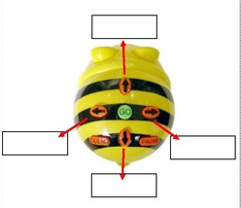
Knowledge Organiser – Spring 1 Fairy-tales Class 1
Geography
1. Name three features of an urban area. 2. Name three features of a rural area.
Computing
1.Label the buttons on the Beebot.
2. Program the Beebot (Oral instructions to be given).
Science
1. Describe 3 different properties of wood.
2. Is it a natural or man-made material?
Art and Design/ Design Technology
1. What is texture?
2. Name 3 materials which you used to create texture.
3. Label the following mechanisms with either lever, slider or wheel. 4. Create a castle using the collaging technique.
PSHE
What is a goal? Write 2 positive learning phrase.
RE
1. Name 1 Bible story.
2. What is a parable?
3. Why is it important to be a Good Samaritan?
MFL
Define these words: Rose – Il pleut – Le parc -
History
1. Label the features of the castle.
Music
What is your favourite artist and why?

