Slide 1
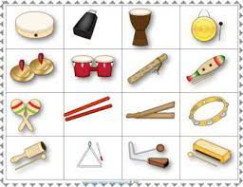
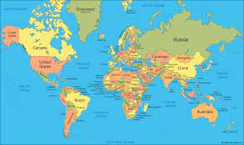
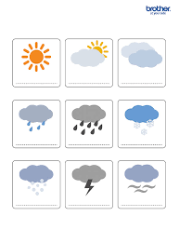
Geography
What I should already know The world is made up of continents and oceans. Some children will be able to begin to name the continents and oceans. Some children can name the seas surrounding the UK All children understand that the world is made up of lots of different countries. | The Journey The children will be discovering what a wonderful world that we live in. The children will explore the 7 continents that make up the world and learn some facts about each. The children will learn about and name the 5 oceans The children will use an atlas, maps, globe and aerial photographs to get a sense of the landscape that makes up our world.
Key Vocabulary Continents Oceans Globe Atlas Aerial photograph | What I will know by the end of the unit Name the 7 continents and 5 oceans that make up our wonderful world. Recall some facts about the 7 continents. How to use an atlas to find out information.
Music
What I should already know Have experience of playing untuned instruments. Performed in front of others. | The Journey The children will have a go at composing their own music building up to writing their own musical score. We will explore and play tuned and untuned instruments. Children will work on their listening skills through a variety of warm up games each week. We will also look at pitch and pulse.
Key Vocabulary Pitch Pulse Compose Musical score Untuned/tuned instruments | What I will know by the end of the unit Understand the meaning of the key vocabulary introduced in this unit. Have composed a piece of music. Began to explore writing a musical score.
Knowledge Organiser – Spring 2 Cartoons Class 1
Science
What I should already know Know the 4 seasons different seasons. Can name different types of weather. Have previously looked at extreme weather across the world. Carried out an investigation over a short period. | The Journey The children are going to use the weather symbols to describe and make their own weather reports. Children will make their own measuring gauges to measure water, wind and temperature and carry out data collection based on findings.
Key Vocabulary Thermometer Rain gauge Wind - sock Weather symbols Investigation Data collection Recording data | What I will know by the end of the unit How to measure data collected in a variety of different ways over a short and longer periods of time. Know what the different weather symbols mean. Have carried out a variety of weather linked investigations such as rainfall, wind and temperature.
Design Technology
What I should already know The children will already know how to use a range of materials to create some simple joins. They have also planned and evaluate designs. | The Journey The children will evaluate different bridges and then will have a go at designing, making and evaluating their own bridges. They will look at making joins stronger and stiffer. They will create a foundation and build on to this.
Key Vocabulary Joins Bridges Stiffer Stronger Design Make Evaluate | What I will know by the end of the unit By the end of the unit the children will know about different types of bridges and their purposes. They will know how to create joins and will be able to use their skills to design their own. They will then implement their knowledge of joins to create a bridge of their own. All children will be given the opportunity to evaluate their products.

Slide 2
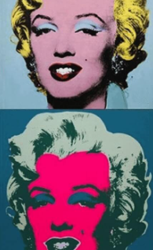
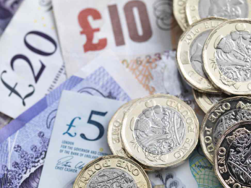
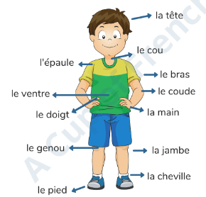
PSHE
What I should already know The children have already learnt about setting goals. They have discussed their aspirations for the future and jobs which they desire to do. | The Journey This unit encourages children to think about where money comes from and how it can be used. Children will discuss the idea of spending and saving their money and begin to understand why it is important to keep belongings, including money, safe.
Key Vocabulary Money, employment, work, job, payment, wages, spending, saving, bank | What I will know by the end of the unit By the end of the unit the children will learn ways in which they can save money. They will also learn to differentiate between needs and wants. They will be able to suggest resolutions for financial scenarios.
RE
What I should already know The children have already learn about Christianity and Hinduisms. They know that each religion has a place of worship and holy books. They have looked at different religions celebrations. The children have also learnt about the Bible and Vedas. They heard stories from these holy books too. | The Journey The children will learn about the origination of Judaism. They will learn about the different features of a synagogue and importance of one. They will look at the torah and stories in the torah. The children will also learn about the celebration of Hannukah.
Key Vocabulary Hannukah Torah Synagogue Judaism Shabbat Moses Rabai | What I will know by the end of the unit They will learn about the different routines and rituals which are carried out by Jewish people. They will learn about Moses and the importance which he has on Judaism. The children will also learn to make connections between religions they have already learnt about.
Art
What I should already know The children have looked at the work of artist Andy Goldsworthy. They have used a range of different tools and techniques. | The Journey The children will learn about animation and the different changes which have been made to create animations. They will look at the work of Andy Warhol and will learn to create art in his style.
Key Vocabulary Animation Lines Pop art Andy Warhol Bright | What I will know by the end of the unit The children will know how to follow step by step instructions to create an animation. They will create an animation of their own and will evaluate the work of Andy Warhol. They will create a piece of art work in the style of Andy Warhol.
Knowledge Organiser – Spring 2 Cartoons Class 1
Computing
What I should already know The children have used Beebots previously and know how to use buttons to create an algorithm. They have debugged their algorithms too. | The Journey This unit introduces learners to on-screen programming through ScratchJr. Learners will explore the way a project looks by investigating sprites and backgrounds. They will use programming Blocks to use, modify, and create programs.
Key Vocabulary Sprite, command, blocks, background, algorithm, program. | What I will know by the end of the unit By the end of the unit the children will be able to program a sprite and use simple commands to create an algorithm. Some children will be able to change backgrounds and use blocks to give their sprites commands.
PE
Key skills in PE n this unit, pupils will develop their fundamental ball skills such as throwing and catching, rolling, hitting a target, dribbling with both hands and feet and kicking a ball. Pupils will have the opportunity to work independently, in pairs and small groups Forest school weekly sessions.
MFL
Key Phrases La tête La jambe La main La nez Chein Lapin Poisson Tortue

Slide 3
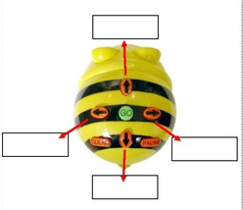
Knowledge Organiser – Spring 2 Cartoons Class 1
Geography
Computing
Science
Art and Design/ Design Technology
PSHE
RE
MFL
Define these words:
History
Music

