Slide 1
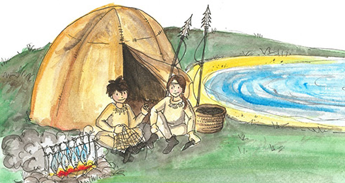
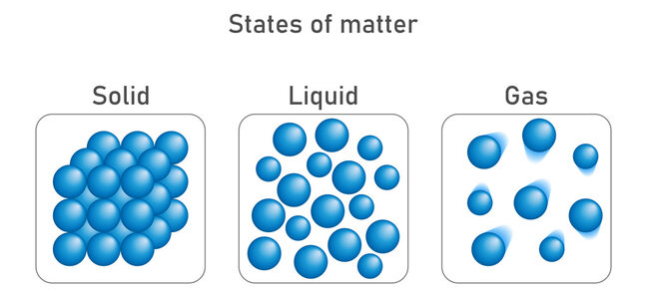
Knowledge Organiser – Spring 2 2023, Stone Age (Class 2)
Geography
What I should already know How to use a map to locate a region, county and town focussing on the local area. | The Journey Describe what you find underground. Explain… How volcanoes are formed. How volcanoes affect people’s lives. What causes earthquakes and how they are measured.
Key Vocabulary | What I will know by the end of the unit Describe how a volcano is formed, when a volcano erupts and some risks and benefits of living near a volcano. Explain why earthquakes occur and compare the strengths of earthquakes.
History
What I should already know Events beyond living memory that are significant nationally or globally.​ | The Journey Put events in chronological order. Find out about how hunter-gatherers lived in Stone Age Britain. Explore the style of Stone Age cave art. Examine non-written sources of evidence about the Stone Age.
Key Vocabulary | What I will know by the end of the unit Understand how the period from the Stone Age to the Iron Age fits into a wider picture of British history.
Stone Age | Chronological | Cave paintings
Palaeolithic | Mesolithic | Neolithic
Hunter-gathers | Prehistory | Significant events
Eruption | Magma | Crater
Magma chamber | Active | Dormant
Extinct | Magnitude | Richter
Science
What I should already know Compare and group together a variety of everyday materials on the basis of their simple physical properties. | The Journey Compare and group materials together. Investigate gases and explain their properties. Investigate materials as they change state. Explore how water changes state. Explain the effect of temperature on the process of evaporation.
Key Vocabulary | What I will know by the end of the unit Describe the properties of solids, liquids and gases. Explain the behaviour of the particles in solids, liquids and gases.
Computing
What I should already know Use technology purposefully to create, organise, store, manipulate and retrieve digital content. | The Journey Explain that data gathered over time can be used to answer questions. Use a digital device to collect data automatically. Explain that a data logger collects ‘data points’ from sensors over time. Recognise how a computer can help us analyse data. Identify the data needed to answer questions.
Key Vocabulary | What I will know by the end of the unit Use data from a sensor to answer a given question. Identify the intervals used to collect data and sort data to find information using a data logger.
Solid | Liquid | Gas
State | Particles | Properties
Condense | Evaporate | Water vapour
Data | Sensor | Logging
Interval | Import | Export
Analyse | Logged | Collection

Slide 2
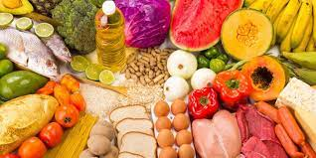
PSHE
What I should already know Discussed jobs I might like to do when I grow up and what skills are needed to achieve this. | The Journey Explain… What skills are needed for a range of jobs. Ways people can borrow money and discuss some of the consequences of borrowing money. The difference between things we want and things we need. Ways I can keep track of what I spend and why it is important to do this.
Key Vocabulary Money, employment, job, payment, wages, spending, owe, save, borrow, interest, repayments, credit card, budget. | What I will know by the end of the unit Understand where money comes from and how it can be used. Consider what influences spending and how to keep track of what we spend.
RE
What I should already know Made links between religious beliefs and teaching and why people try to live and make the world a better place. | The Journey Identify some beliefs about love, commitment and promises. Understand the significance of baptism to Christians. Understand how Jewish people mark becoming an adult. Acknowledge which ceremonies Hindus mark in the journey of life.
Key Vocabulary Ambitions, hopes, dreams, commitments, values, journey, forgiveness, salvation. | What I will know by the end of the unit How and why people mark the significant events of life.
Art
What I should already know Produced artwork inspired by other artists. | The Journey Identify what a landscape is. Use line, tone and shade effectively. Make rubbings using appropriate textures. To sketch a local landscape.
Key Vocabulary Landscape, skyline, Ken Done, Joan Miro, shade, tone. | What I will know by the end of the unit To sketch a local landscape in the style of Ken Done.
Knowledge Organiser – Spring 2 2023, Stone Age (Class 2)
Music
What I should already know How to read, clap and play crotchets, quavers, rests, minims and semibreves.​ ​ Experience with writing a musical composition. | The Journey To know what a recorder is; how to look after and clean it and the different parts​ To experiment with making sound using the recorder​ To use my tongue to make my notes clear and consistent​ To be able to play and recognise the notes B,A and G​ To play notes in time with a given rhythm​ To begin to recognise the notes B, A and G on sheet music​
Key Vocabulary Recorder, note, rhythm, staff, crotchet, minim, semibreve, crotchet rest | What I will know by the end of the unit To play the notes B, A and G on a​ recorder and begin to play a simple​ tune.
Design Technology
What I should already know The principles of a healthy and balanced diet. | The Journey How to maintain food hygiene and safety To follow a step by step recipe
Key Vocabulary Cookery, savoury, technique, hygiene, safety, recipe, ingredients, crockery. | What I will know by the end of the unit How to prepare and cook a variety of predominately savoury dishes using a range of cooking techniques.
MFL
Key Phrases Les nombres [numbers], Comptes avec moi [Count with me], fois [times], divisé par… [divide by…], C’est combien? [How many is that?], Ça fait combien? [How many does that make?, C’est quel jour? [What Day Is It?], Faites la semaine [Make a Week].
PE
Key skills Netball- Passing, moving, catching, reacting, turning, shooting, communicating, attacking and defending.

