Slide 1
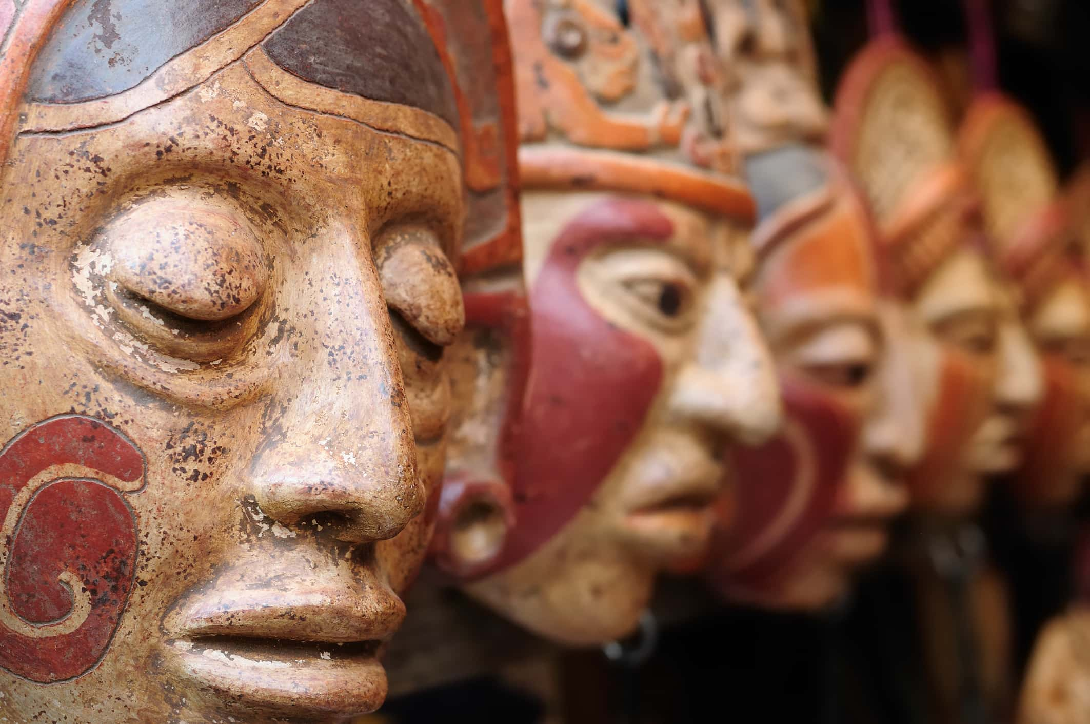
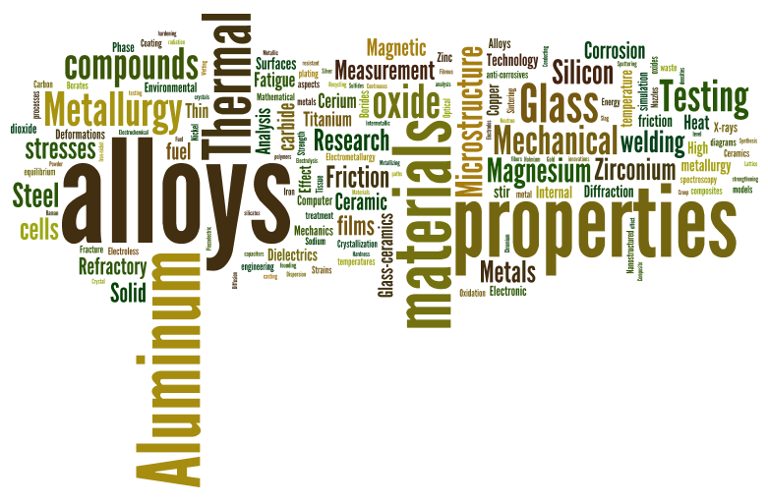
Knowledge Organiser – Summer 1 Changes Class 3
History
What should I already know Other ancient civilisation to make a comparison Greeks Romans | The Journey The children will learn who the ancient Maya people were, where and when they lived, researching learning facts and answering questions.
Key Vocabulary civilisation, sacrifice, worship, bloodletting, ritual, Xibalba, upper world. To continue from last half term Darwin autobiography- Evolution. | What I will know by the end of the unit They will use maps and atlases to locate Maya cities and identify countries in Mesoamerica. They will learn about the religious beliefs and rituals of the ancient Maya people and find out more about some of the many gods they worshipped. The children will also learn about the Maya number system.
Art
What I should already know We have sketched wild life We have sketched using charcoal and pastels-looked at perspective. | The Journey The children will learn how to mix appropriate colours and tones from a range of media. We will study a range of photographs, images of the natural environment: mountains, rivers, water, waves, waterfalls, hills, fields
Key Vocabulary Range Media Environment Image stimulus | What I will know by the end of the unit They be able to mix a range of colours and tones to create our own pieces of art. We will be able to talk about different images from a geography and art point of view.
Science
What I should already know Materials and their properties in earlier year groups, including: transparency, magnetism and states of matter | The Journey The children will compare and group together everyday materials on the basis of their properties, including their hardness, transparency and response to magnets by sorting and classifying materials according to their properties.
Key Vocabulary material, property, magnetic, hard, transparent, flexible, permeable. | What I will know by the end of the unit They will be able to plan and carryout an investigation explaining orally and then to succinctly write down findings. Be able to ask questions to generate further ideas to carry out investigations
Computing
What I should already know The children have had experience of using a range of apps and programs. We have used the internet for research | The Journey Children will be introduced to creating websites for a chosen purpose. They identify what makes a good web page and use this information to design and evaluate their own website using Google Sites. Throughout the process, children's pay specific attention to copyright and fair use of media, the aesthetics of the site, and navigation paths.
Key Vocabulary Website Copyright Navigate aesthetics | What will I know at the end of the unit The children will have increased understanding of: digital writing, digital painting, desktop publishing, digital photography, photo editing, and vector drawing.
This Photo by Unknown Athor is censed under CC BY-SA

Slide 2
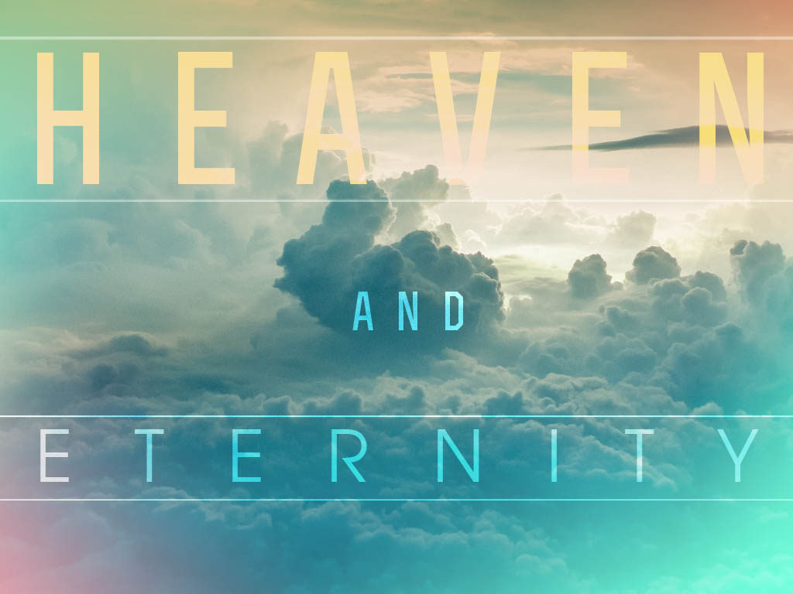
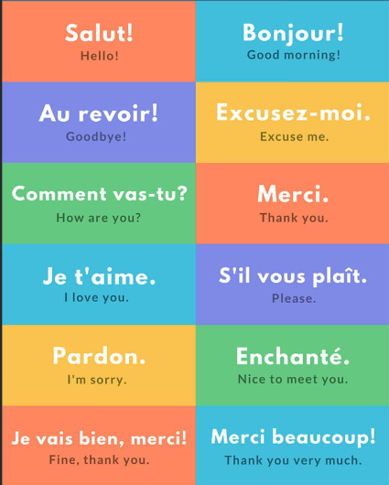
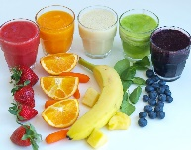
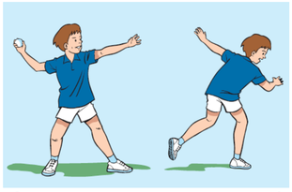
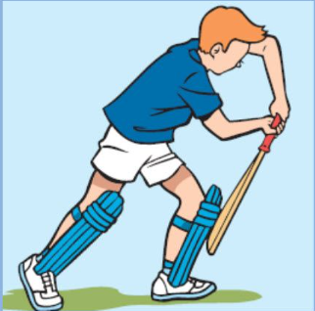
PSHE
What I should already know The children have considered the concept of consequences of choices. The children have discussed successful group-work skills. | The Journey Discussions and debates: How to show respect Belonging to a community How laws help Local government in relation to democracy and human rights National government in relation to democracy and human rights How charities and voluntary groups help meet the needs of all people in the community
Key Vocabulary faith, ethnicity, respect, similar, different, consequence, right, equal, responsibility, diversity, difference, community, society | What I will know by the end of the unit The children will identify how they can make a positive contribution to the community.
RE
What I should already know The children to have studied at least one unit for each of the six major world religions Children will have learnt about life cycles in science in Year 5 | The journey The children will explore the definition of and popular ideas relating to the concept of eternity. They will compare concepts of eternity from both religious and non-religious worldviews. This will culminate in an end of unit project, where children will reflect on and create a presentation based on their learning.
Key Vocabulary Eternity Immortality Mortality Heaven | What I will know by the end of the unit The children will be able to talk about: Re-Incarnations – religious beliefs Interpretations of the after life
MFL
The children will develop their French writing skills to write a short letter linking to the oral work they have done throughout the year: Introduce themselves - age, name, where they live and their favourite activities. Ask a question Close the letter
Knowledge Organiser Summer 1 Changes Class 3
Music
What I should already know To sing with confidence when learning songs Key Vocabulary Adagio Andante Tempo Control discipline | The Journey The children will learn as they sing the story that they will perform of Alice the Musical. They will learn key musical words and gain confidence in performance. What I will Know by the end… The songs and the production and an understanding of Lewis Carroll.
Design Technology
What I should already know Cooking and nutrition Healthy diet Varied diet Seasonality | The Journey To consolidate and understand the different food groups. To consider your balanced diet. To think about good sugars and encourage a healthy drink!
Key Vocabulary Balanced healthy Diet Natural | What I will know by the end of the unit Smoothies Design-Make-Evaluate
PE
Key skills Cricket and Rounders Catching Throwing Bowling Rules Striking Body position Weigh transfer Team skills Scoring
This Photo by Unknown Author is licensed under CC BY-ND
Notes:
Healthy’Natural

Slide 3
Topic 20 Quiz Changes
Geography/History
PSHE
RE
Music
Computing
Science
Art and Design/ Design Technology
Can you name the 7 different food groups?
What is a varied diet?
Vocabulary – define these words
Accuracy Precision Complexity Inflation Investment

