Slide 1
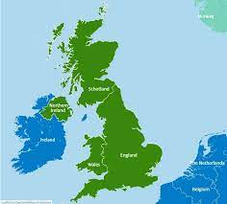
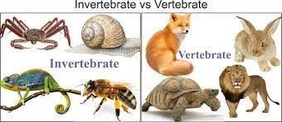
Knowledge Organiser- Summer 1 2023, Great Britain (Class 2)
Geography
What I should already know Identify Europe on a ​world map.​ Locate European capital ​cities on a map.​ Identify landmarks belonging ​to different European cities.​ | The Journey To name and locate the countries and cities of the UK. To name and locate the main rivers and seas of the UK. To name and locate some of the countries of the UK. To name and locate areas of high ground in the UK. To identify ways that London has changed over time.
Key Vocabulary | What I will know by the end of the unit Locate the countries that make up the UK on a map. Name and label the capital cities in the UK.
United Kingdom | Great Britain | River
Sea | County | Country
Town | Immigration | Growth
Science
What I should already know Identify and name a variety of common animals including fish, amphibians, reptiles, birds and mammals. Identify and name a variety of common animals that are carnivores, herbivores and omnivores. | The Journey To group living things in a range of ways. To generate questions to use in a classification key. To use a key to identify invertebrates. To create a classification key. To recognise positive and negative changes to the local environment.
Key Vocabulary | What I will know by the end of the unit How to sort living things into groups. Be able to generate questions about animals. See similarities and different between vertebrates.
Computing
What I should already know Understand what algorithms are, how they are implemented as programs on digital devices, and that programs execute by following precise and unambiguous instructions. | The Journey To explain how digital devices function. To identify input and output devices. To recognise how digital devices can change the way that we work. To explain how a computed network can be used to share information. To explore how digital devices can be connected. To recognise the physical components of a network.
Key Vocabulary | What I will know by the end of the unit Explain that digital devices accept inputs. Classify input and output devices and explain how digital devices can be used for different activities.
Habitat | Environment | Characteristics
Classification | Vertebrates | Invertebrates
Variation | Wildlife | Change
Digital device | Input | Process
Output | Program | Non-digital
Connection | Network | Server

Slide 2
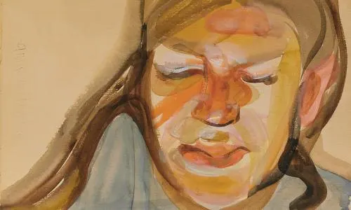
PSHE
What I should already know Understand where money comes from and how it can be used.​ Consider what influences spending and how to keep track of what we spend. | The Journey To describe what it is like to live in the British Isles. To talk about what democracy is and understand why it is important. To talk about what rules and laws are and identify how they help us. To describe a diverse society and talk about why it is important.
Key Vocabulary Multicultural, society, difference, diverse, richness, religious, ethnic, identity, culture, region, county, value, respect, belief, tradition. | What I will know by the end of the unit Describe what it is like to live in Britain, talk about what democracy is and about what rules and laws are.
RE
What I should already know How and why people mark the significant events of life.​ | The Journey To describe how Jews show their beliefs through worship in festivals. To identify some Jewish beliefs about God, sin and forgiveness. To make clear links between the story of the Exodus and Jewish beliefs about God and his relationship with the Jewish people.
Key Vocabulary Blessings, shabbat, Synagogue, Torah, ceremonies, celebrations. | What I will know by the end of the unit Identify some Jewish beliefs about God, sin and forgiveness and describe what they mean. Make clear links between the story of the Exodus and Jewish beliefs.
Art
What I should already know Produced work inspired by other artists. | The Journey To draw illustrations in the style of Puala Rego. To paint part of a famous artwork. To learn about Sonia Boyce.
Key Vocabulary Pattern, colour, portrait, texture, shape, form, senses, sensory. | What I will know by the end of the unit To make a portrait using colour.
Knowledge Organiser – Summer 1 2023, Great Britain (Class 2)
Design Technology
What I should already know How to design, make and evaluate a product for a given purpose. | The Journey Looking at musical instruments. Exploring stretched strings and rattles. Design and make a musical maker. Evaluate a musical maker.
Key Vocabulary Hazards, explore, design, make, evaluate, explain. | What I will know by the end of the unit Design, make and evaluate a musical instrument.
MFL
Key Phrases Onze, douze, treize, quatorze, quinze, seize [11-16], vingt, trente [20, 30], vingt-et-un, trente-et-un [21/ 31] fois [times], divisé par… [divide by…], C’est combien? [How many is that?], Ça fait combien? [How many does that make?].
PE
Key skills Catching, throwing, batting, running, diving, fielding, bowling.

